Slide 1
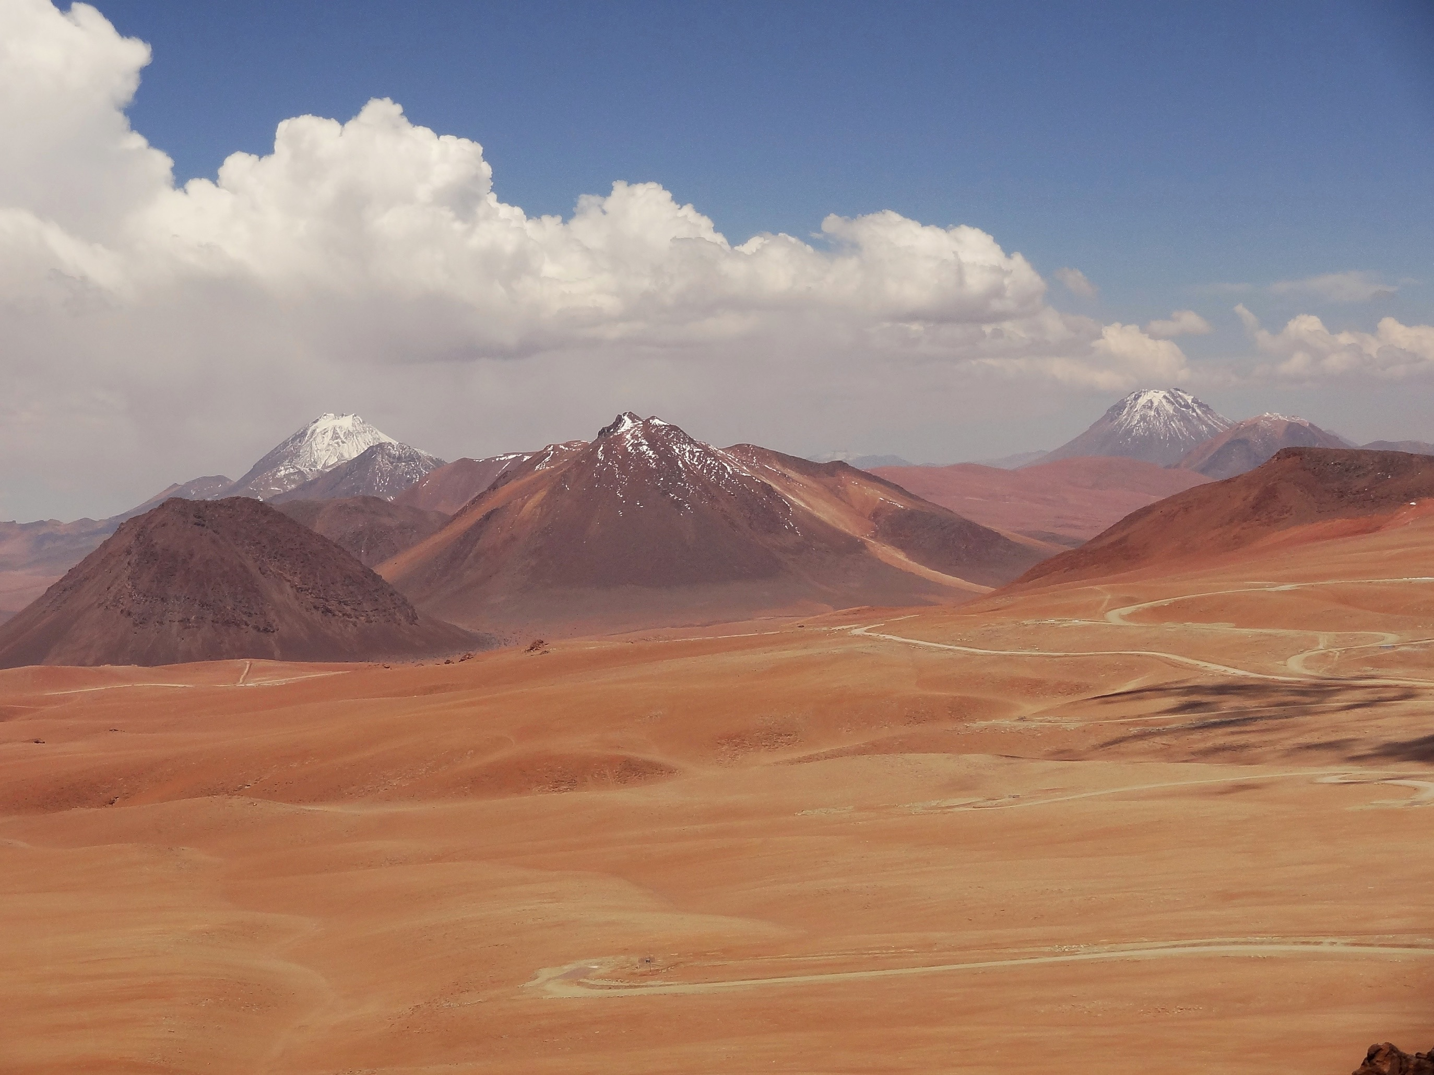
ALMA, Star Formation, and the SOLA Project
Lewis Knee
NRC Herzberg, Victoria BC

Slide 2
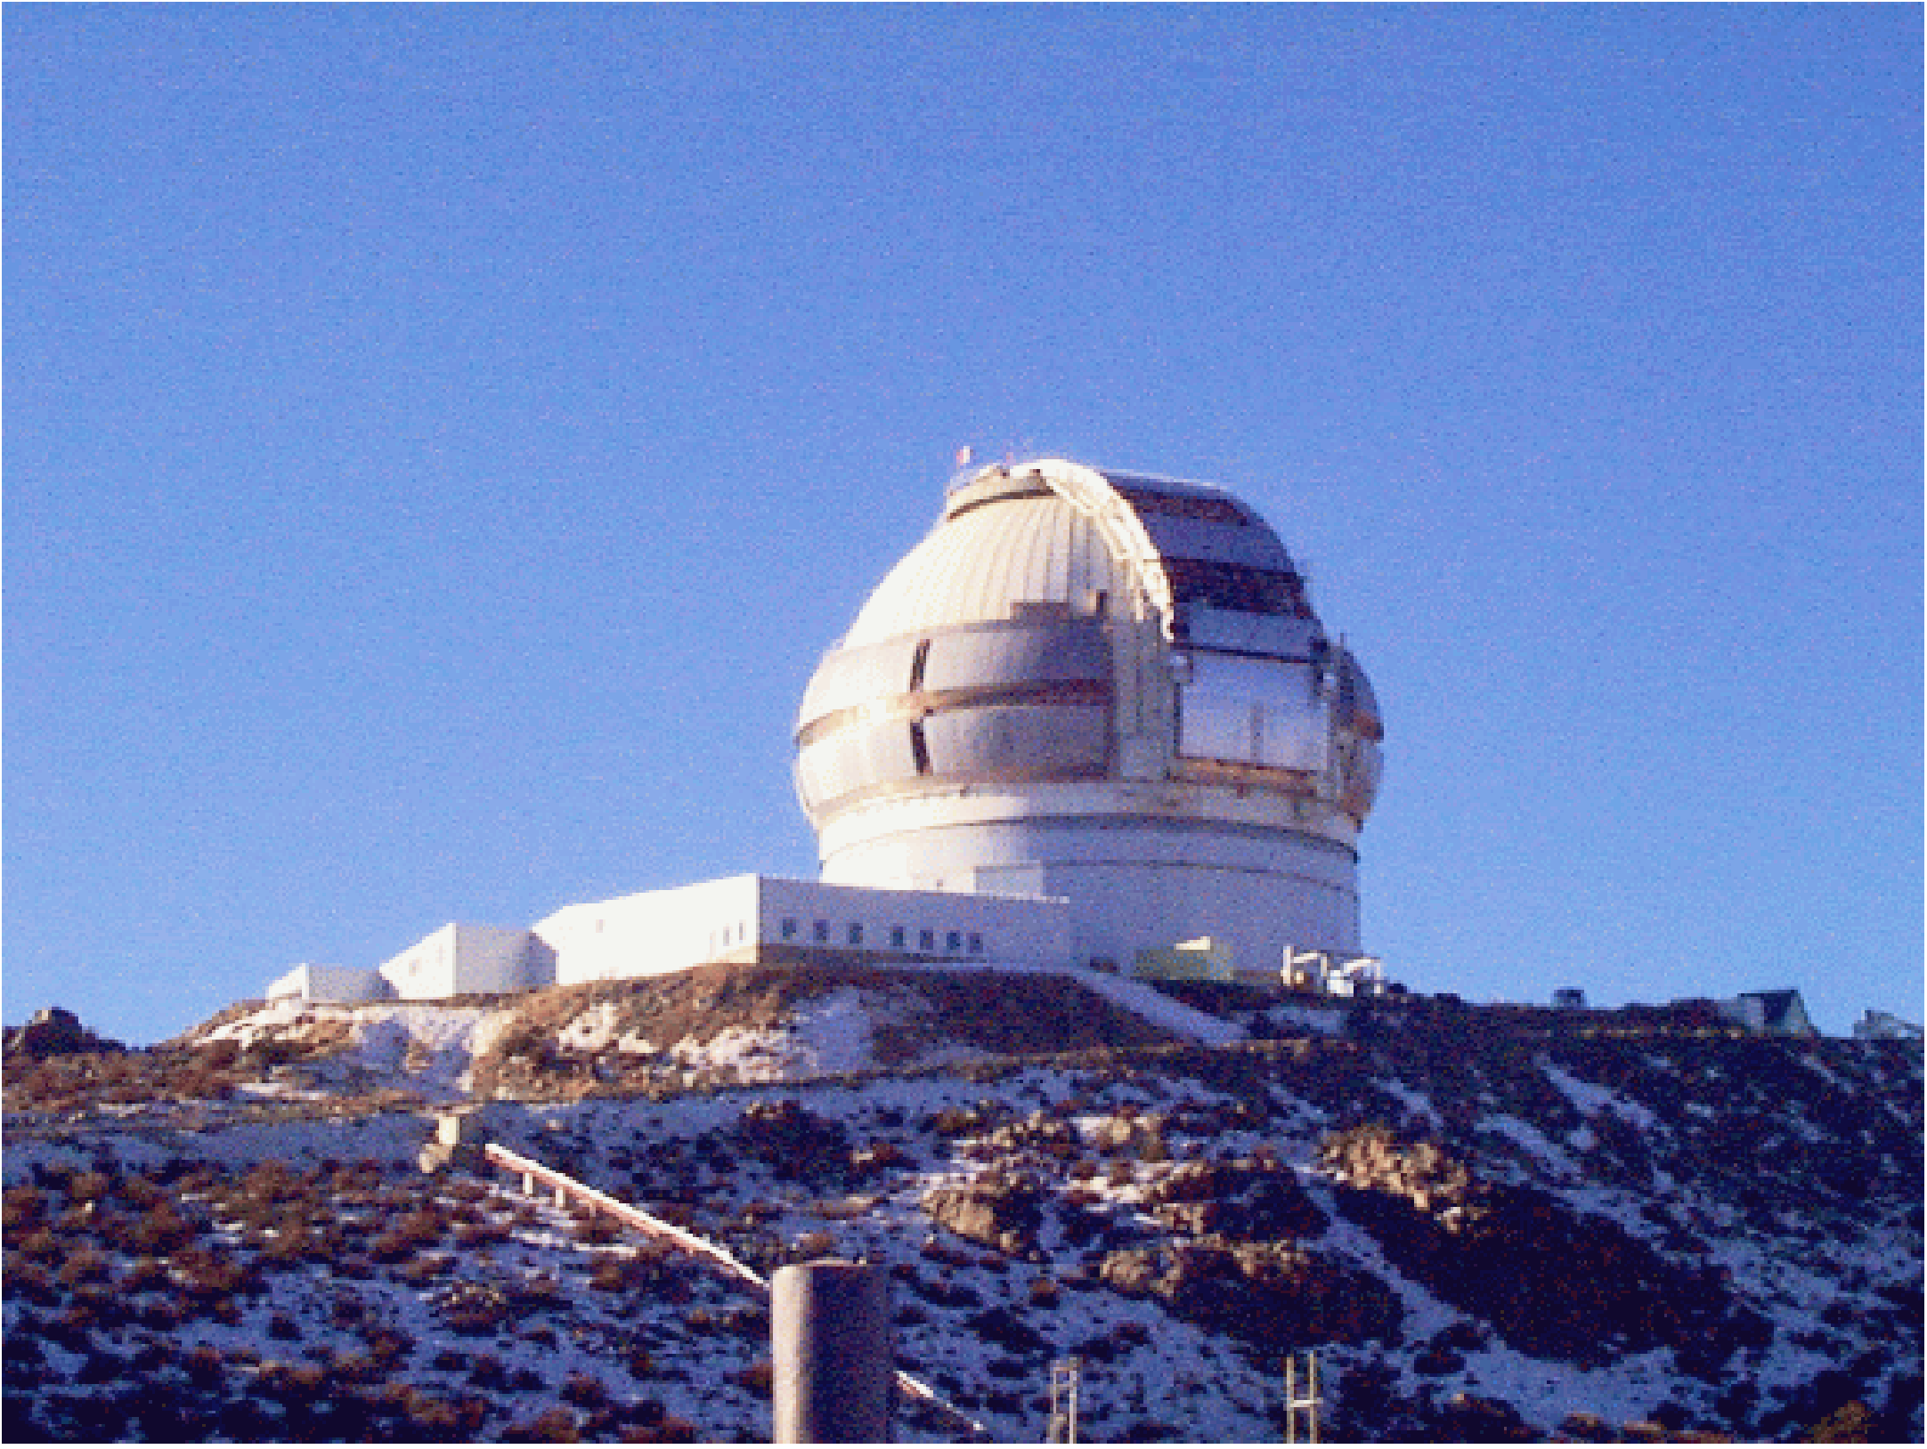
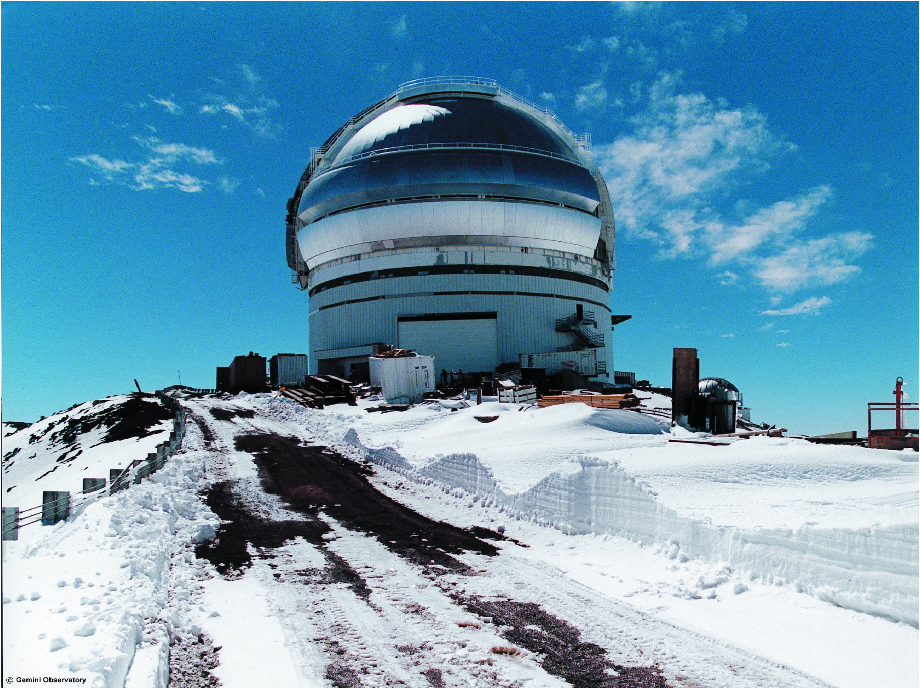
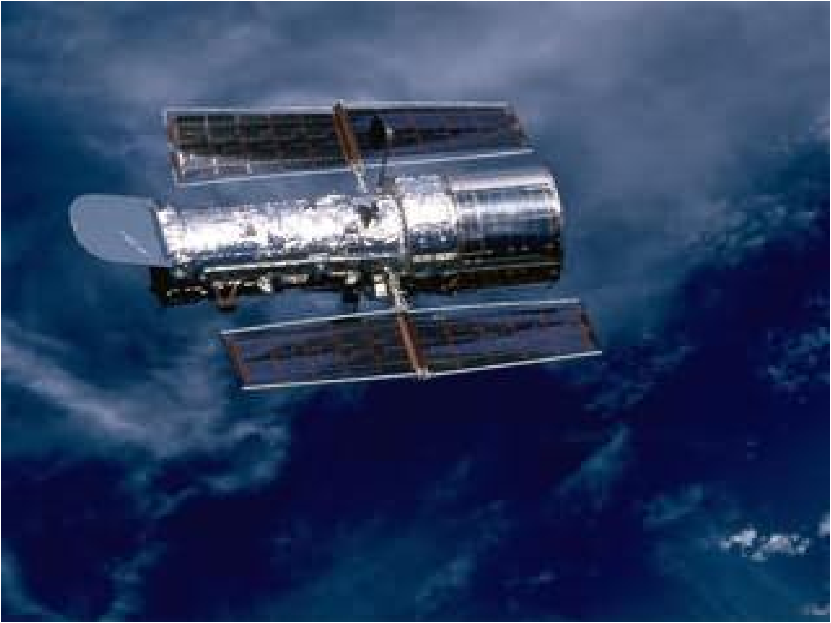
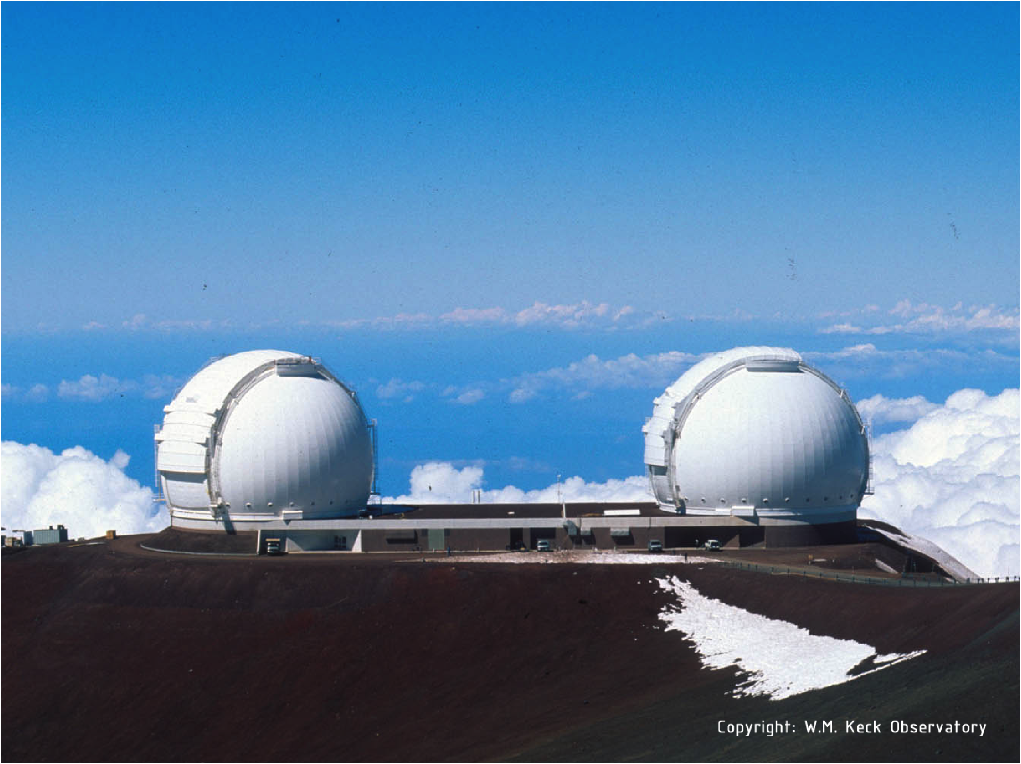
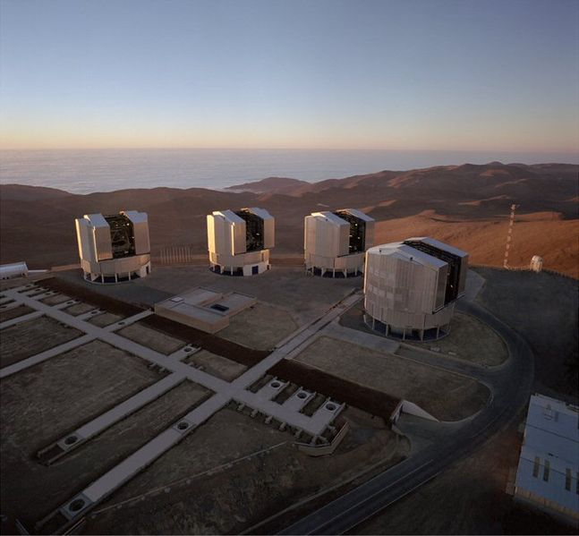
The Hot Universe - The Realm of Optical Telescopes
Hawaii - Gemini North
and Keck I and II
Chile - Gemini South
and the VLT
Earth Orbit - Hubble Space Telescope

Slide 3
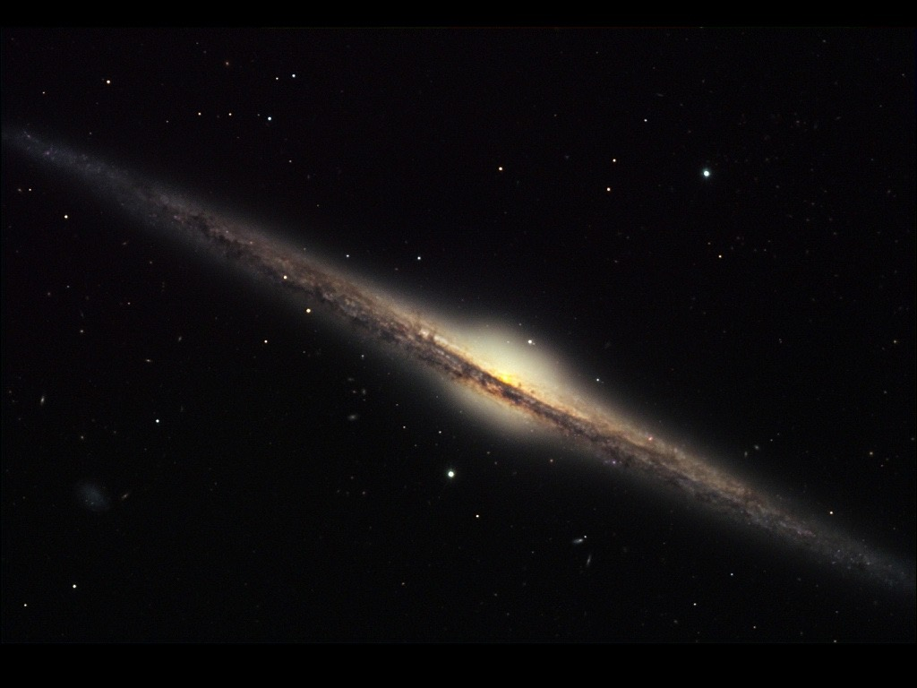
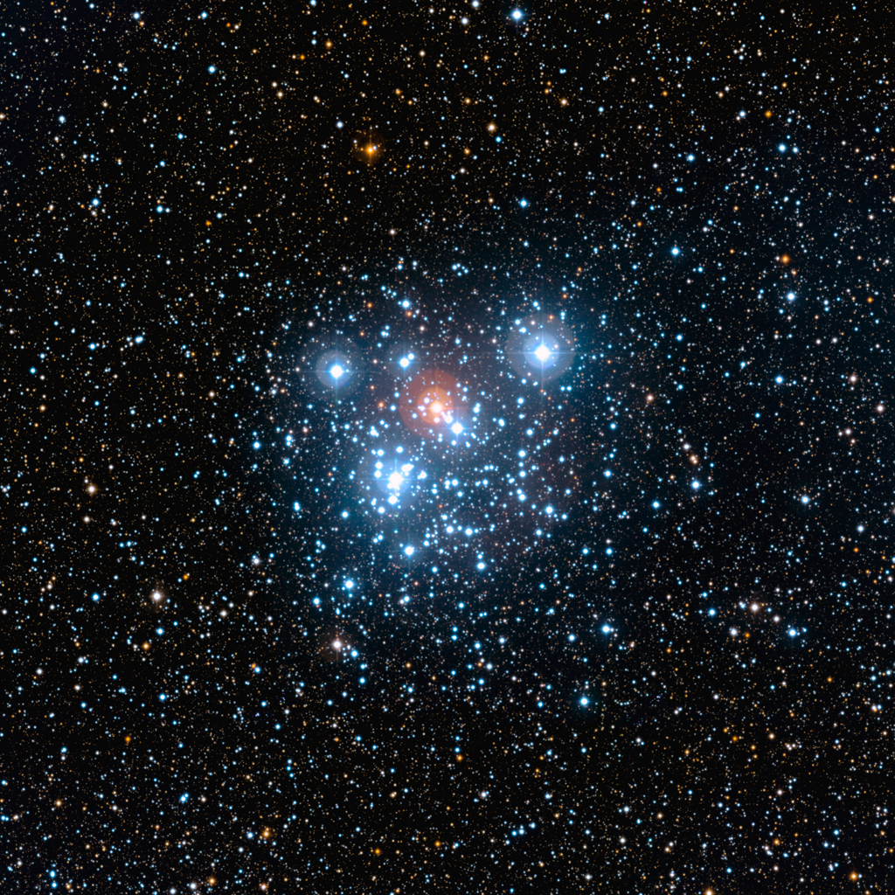
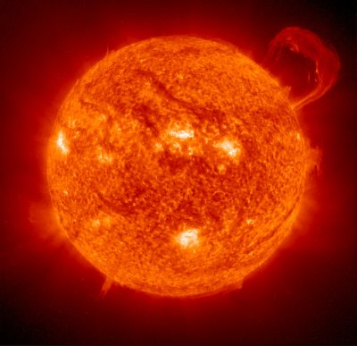
The Hot Universe - Galaxies, Stars
Galaxy NGC 4565
“Jewel Box” star cluster
Sun - ultraviolet

Slide 4
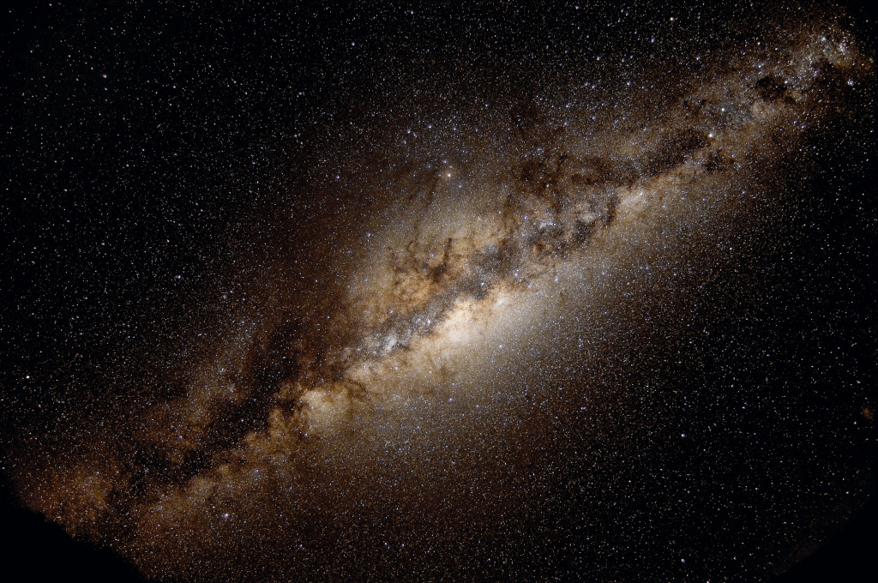
Where does it all come from?
Center of
our Galaxy
Galaxies, stars, and planets form out of vast cold clouds of gas and dust that lie between what we see in the sky
Cold clouds are invisible and opaque to visible light, but the secrets of origins lie within them

Slide 5
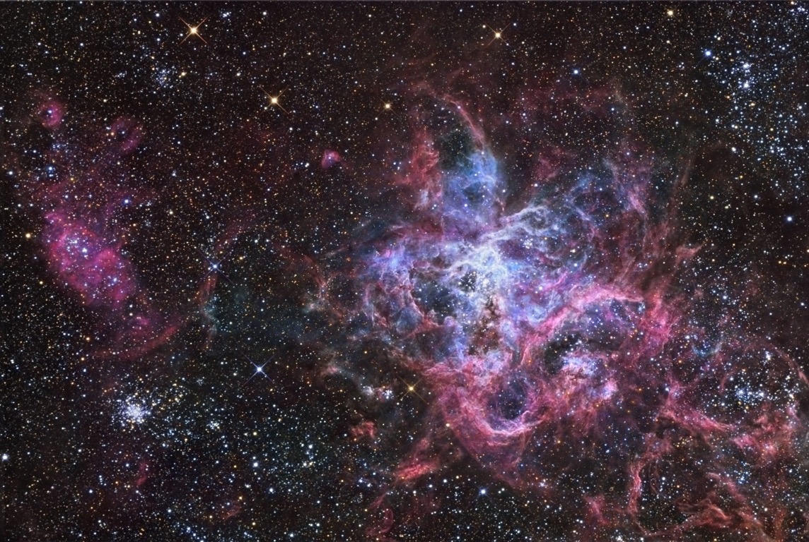
Stars form when the interior of gas clouds collapse. This process is invisible to us because of dust
Newly formed stars heat the surrounding gas, causing it to glow in visible light
Planets form around the stars
NGC 2070 - The “Tarantula” Nebula
in the Large Magellanic Cloud

Slide 6
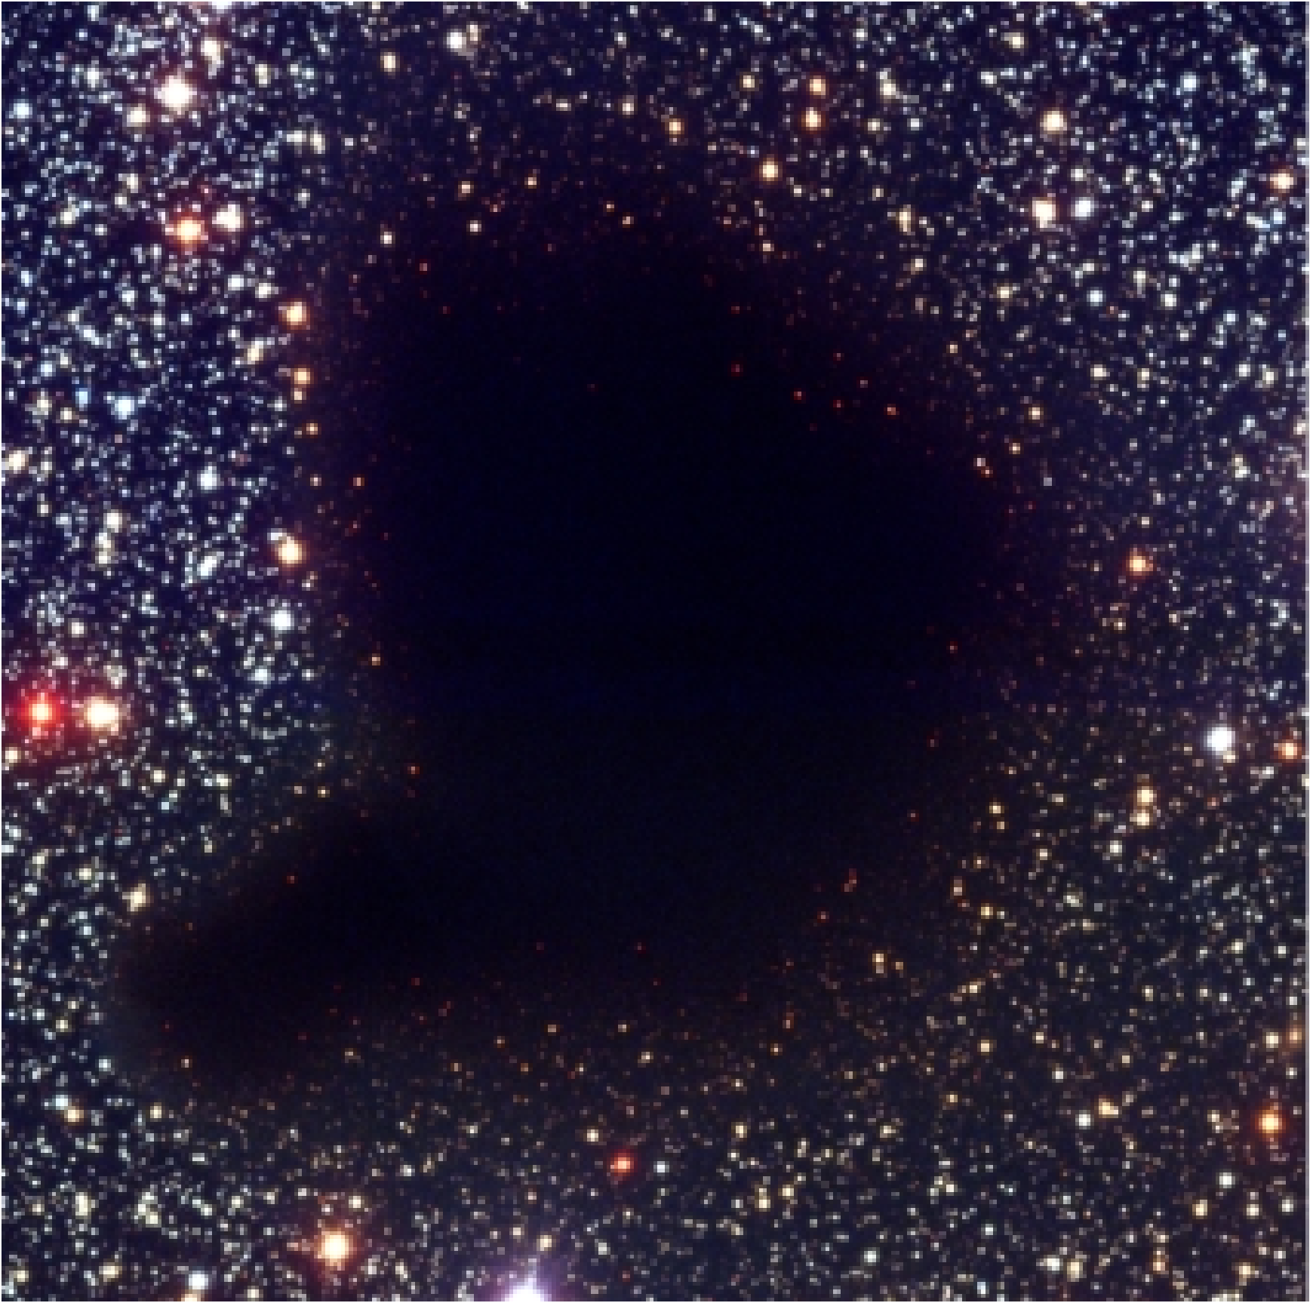
How can we “look” inside?
Barnard 68 - A dusty
molecular cloud
By observing the light which comes from the dust and cold gas!

Slide 7
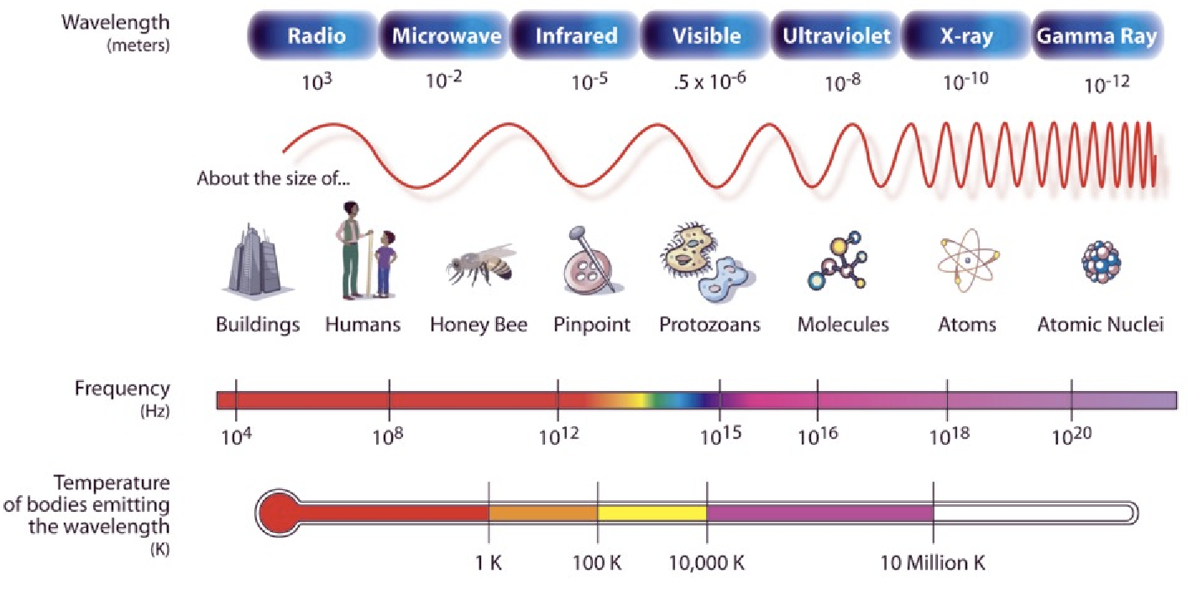
What kind of light?
Interstellar dust and gas molecules emit light with wavelengths about 0.1 mm to 10 mm in size - “millimetre or sub-millimetre light” - also known as “microwaves”

Slide 8
Clouds block optical light and are transparent to infrared light
The millimetre and sub-millimetre light emitted from dust and gas can escape from the clouds, allowing us to see inside
The “Horsehead” nebula seen at four different wavelengths
Visible
Infrared
Sub-millimetre
(molecules)
Sub-millimetre
(dust)

Slide 9
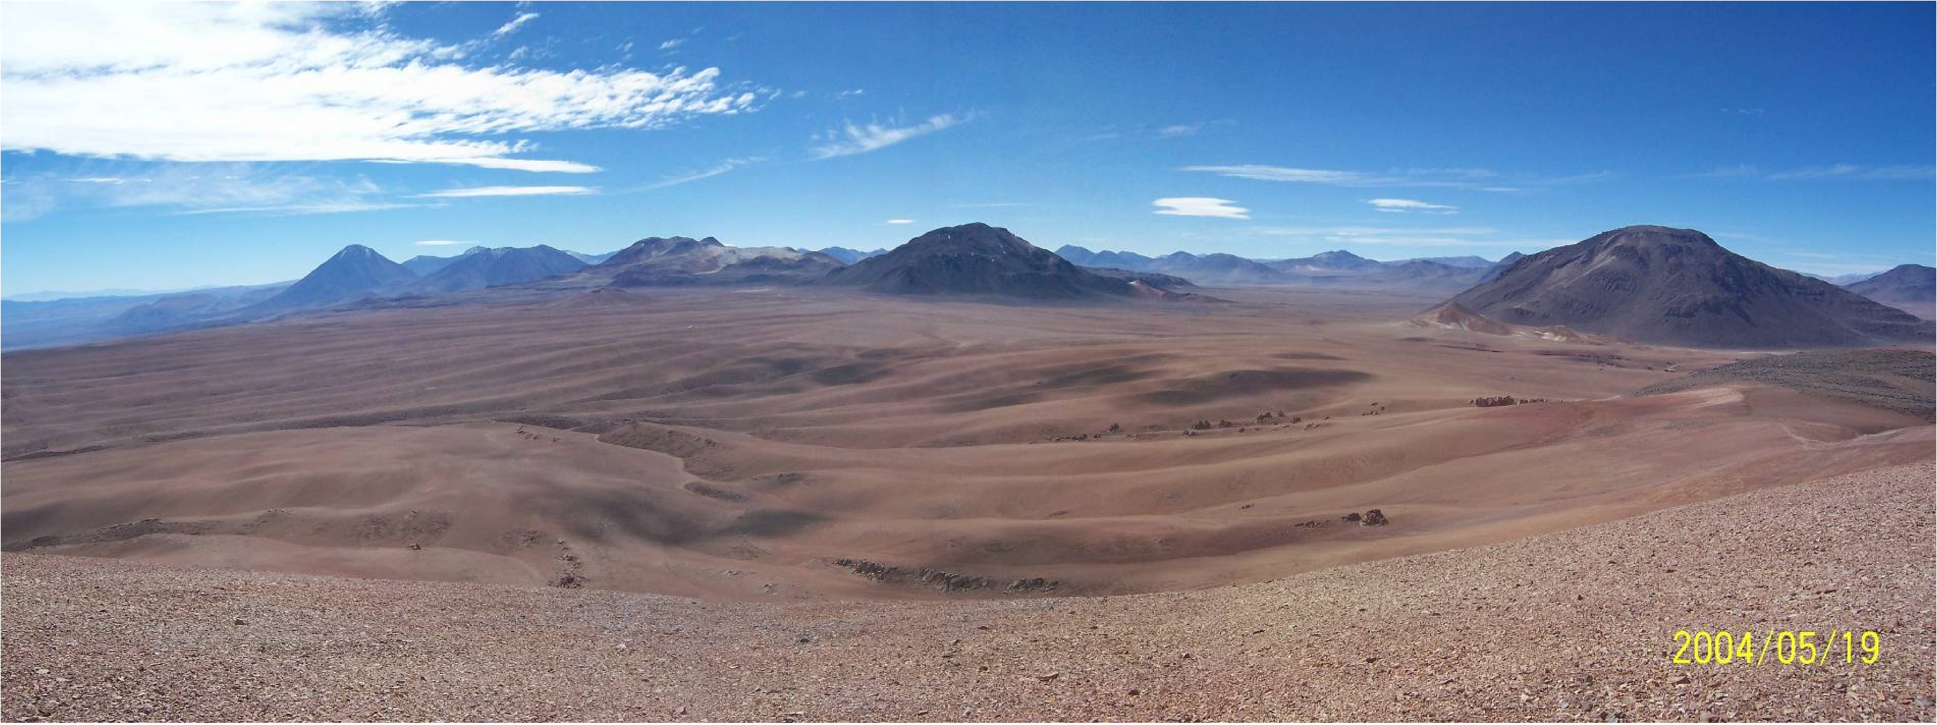
Astronomers can observe sub-millimetre light using radio telescopes designed to operate at high frequencies - about 30 GHz to 1000 GHz
The Earth’s atmosphere and water vapour block sub-millimetre light, making observations difficult or impossible at low altitude and wet sites
Sub-millimetre telescopes need to be built where it is
very high and very dry!
The ALMA site on the Llano de Chajnantor in Chile

Slide 10
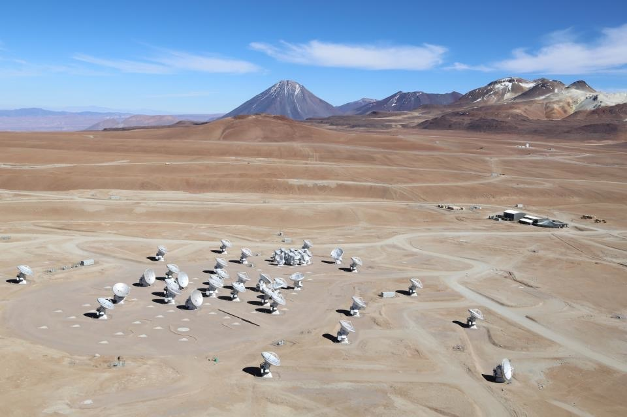
ALMA is an Array of Telescopes
ALMA is an array of telescopes. Why?
We can see fainter astronomical objects
Combining observations(“interferometry”) lets us see fine details
The Atacama Large Millimetre Array is operated by Europe (ESO), North America (USA, Canada), and East Asia (Japan, Taiwan)

Slide 11
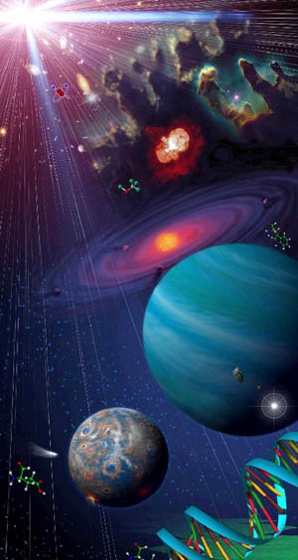
What will ALMA Do?
ALMA will study “cosmic origins”
Formation of galaxies billions of years ago very far away
Formation of stars in nearby galaxies and in our own galaxy
Formation of planets around stars
Chemistry of clouds and new solar systems

Slide 12
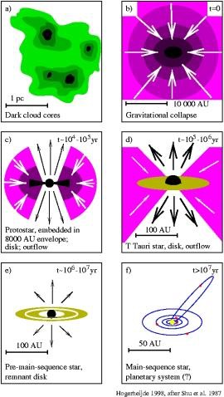
ALMA - Star Formation
With ALMA’s exceptional sensitivity and resolution, we will see stars forming in greater detail than ever before - including
Inside the disks where planets will form
The region near the star and disk where streams of gas are ejected by the protostars

Slide 13
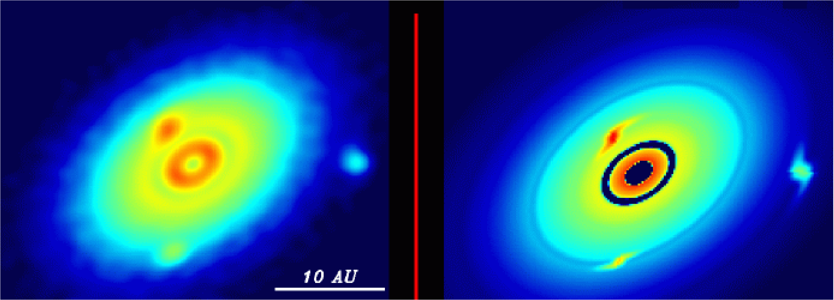
ALMA - Planet Formation
Simulated high-resolution ALMA observation - structures in the disk and proto-planets are detected
Computer simulation of a dusty disk around a newly-formed star with planets forming
These are simulations…

Slide 14
ALMA - Actual Observations!
Outer solar system to scale
Planets forming in the dusty disk of the young star HL Tauri

Slide 15
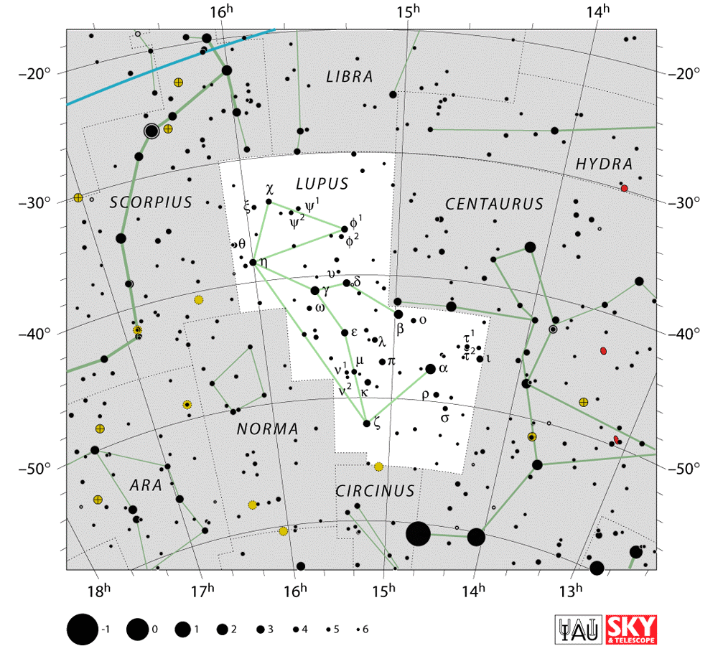
The SOLA Project
A project by ALMA astronomers to study star formation in the southern sky
30 scientists from all the ALMA regions
Our target is star forming molecular clouds in the Lupus constellation

Slide 16
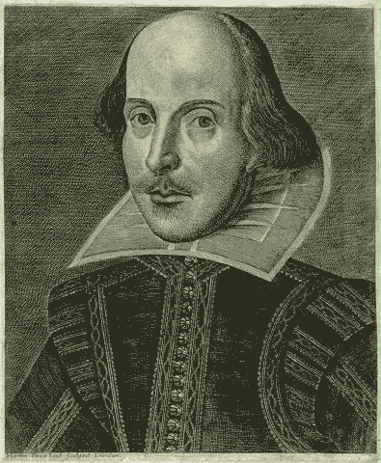
What’s in a Name?
Professional astronomers love clever acronyms for their research projects
SOLA - “Soul of Lupus with ALMA”
“sola” means “sky” in Japanese and “solitary, alone, or unique” in Spanish
“alma” means “soul” in Spanish

Slide 17
Lupus Molecular Clouds

Slide 18
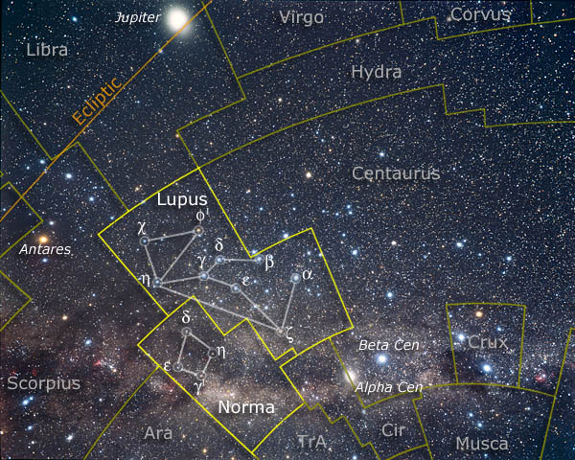
Why Lupus?
Southern - not well studied
Very well placed for ALMA observations
Nearby - 450 light years away
Rich in low mass young stars, especially low mass M dwarfs - an ideal laboratory to study very low mass star formation

Slide 19
Lupus lives in a rough neighbourhood…
Noisy neighbours - ionizing ultraviolet radiation, strong stellar winds, supernova explosions

Slide 20
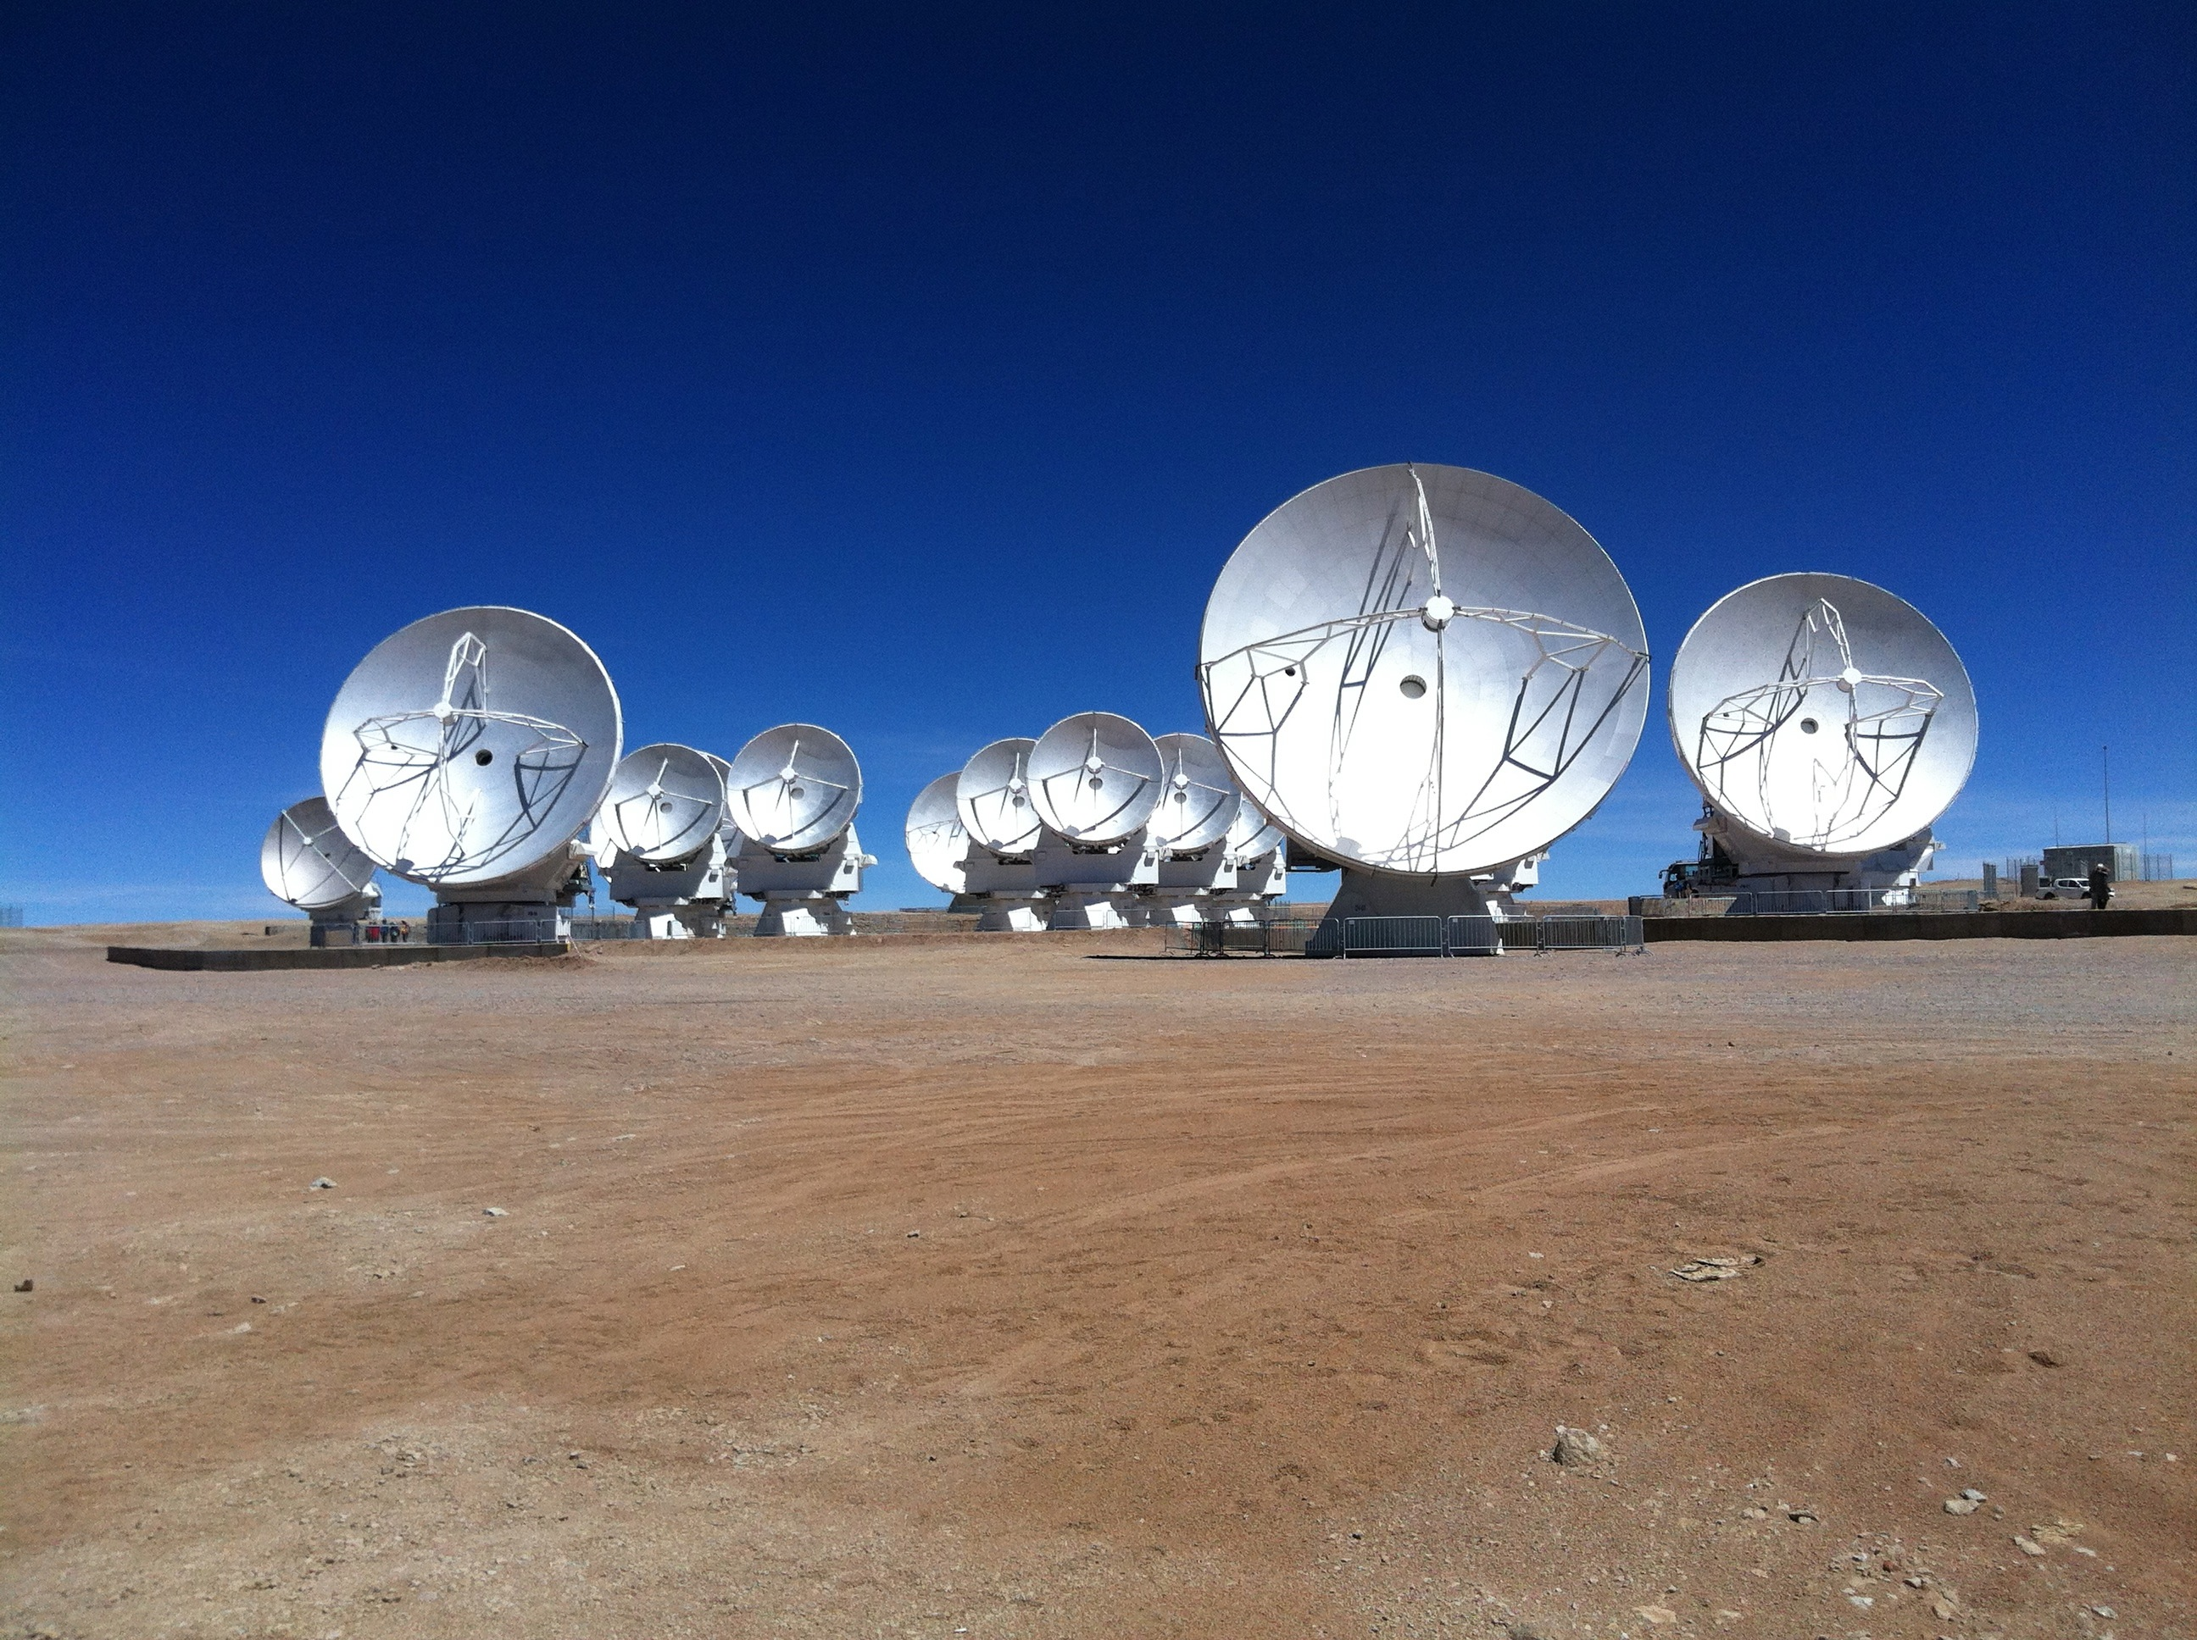
Doing our homework
Observing time on ALMA is very hard to get (10% chance!). Already about 200 papers published since 2012.
Critical to prepare carefully
Survey what is known about Lupus
Preparatory observations from other telescopes

Slide 21
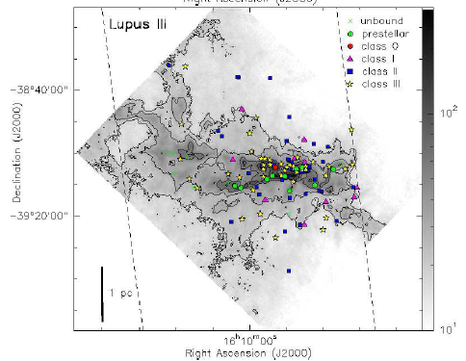
ESA’s Herschel Space Telescope far-infrared and sub millimetre)
Lupus III
Pre-protostellar cores, protostars, and young stellar objects

Slide 22
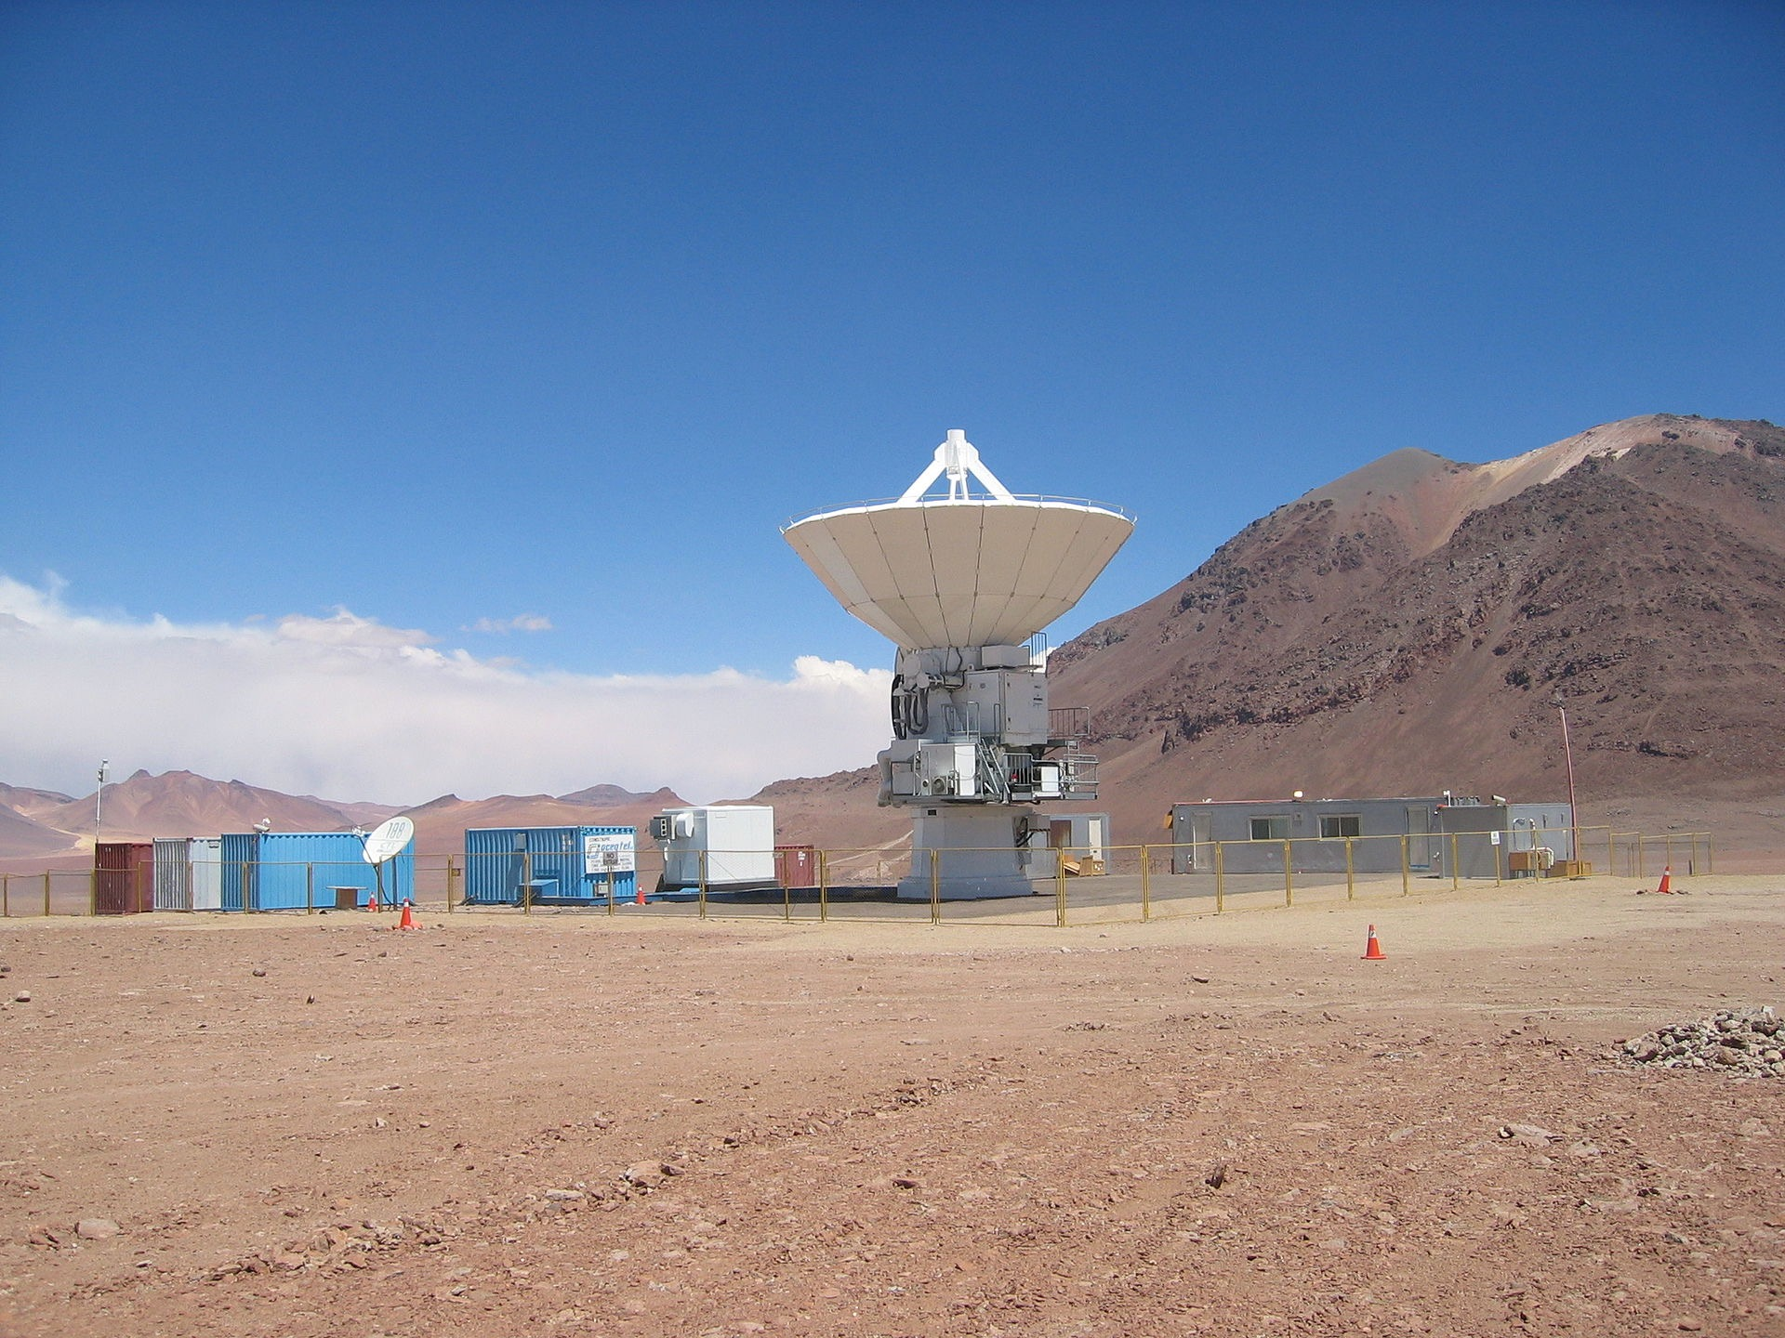
ASTE - Atacama Submillimetre Telescope Experiment
High resolution imaging of dust in the Lupus clouds to identify interesting molecular cores for further study with ALMA using the AzTEC 144-pixel millimetre-wave “camera”

Slide 24
ALMA - Taking the plunge…
Fourth round of ALMA proposals submitted by the international astronomical community
1582 proposals received. A new record…
The SOLA consortium submitted 5 proposals to ALMA

Slide 25
Searching for the protostellar jet in IRAS15398
in atomic carbon at 809 GHz
Proposal #136

Slide 26
Mapping magnetic fields around protostars in Lupus I
Proposal #146
Proposal #136
Do magnetic fields in protostars stay aligned with the field in the surrounding cloud?

Slide 27
Searching for disks around young binary stars
Do disks always form around both stars in a binary?
Does the more massive star always have the more massive disk?
Do the disks interact?
Proposal #197
ALMA observations of misaligned rotating disks in the HK Tauri binary
Proposal #197

Slide 28
Probing the envelope and disk
of the outburst young variable EX Lupi
Prototype of the “EXor” young stellar object irregular varables
Outbursts thought to be triggered by accretion events from the surrounding envelope to the star via the disk
Optical variability - outburst in 2008
Proposal #200
Model prediction for disk in CO gas

Slide 29
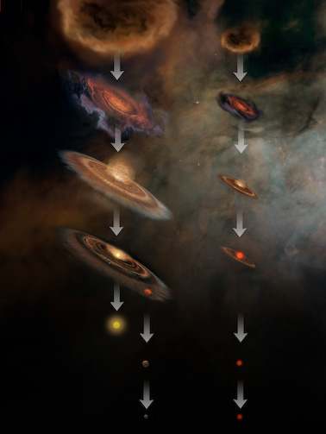
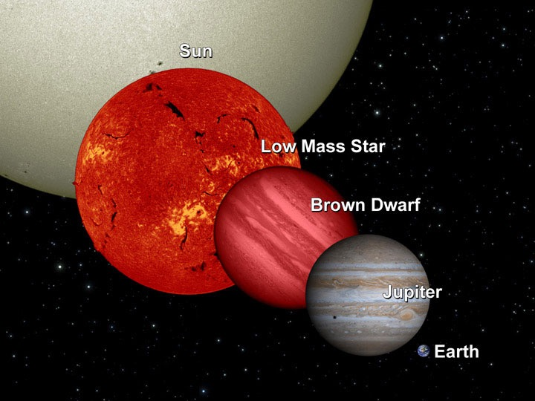
Searching for young brown dwarfs and proto-brown dwarfs
How do brown dwarfs form?
Do they have disks and thus maybe their own planets?
Do they also drive protostellar outflows?
Proposal #512

Slide 30
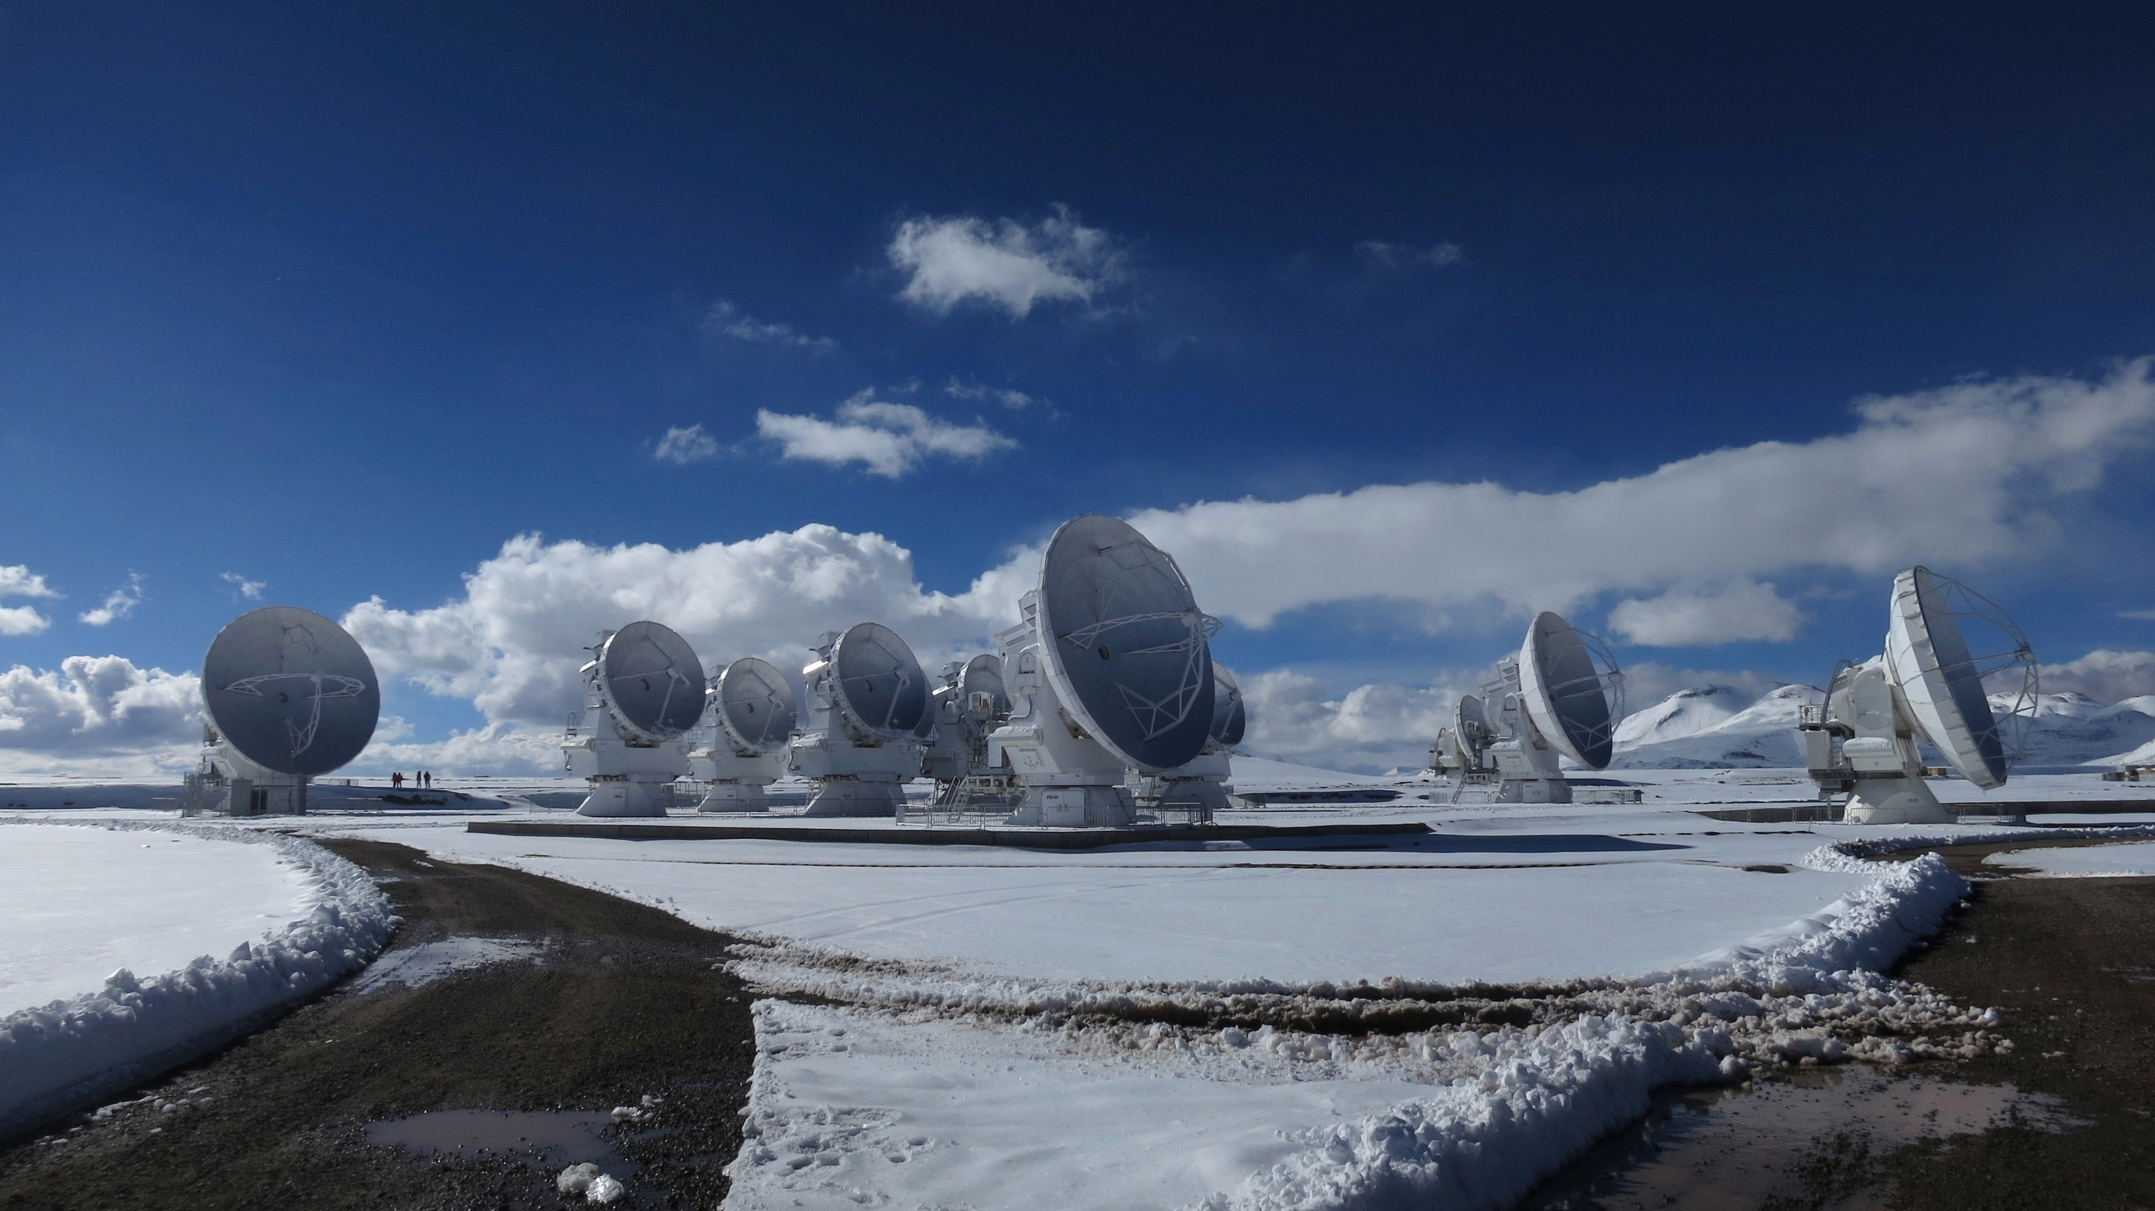
Our goal is to make Lupus as important a region for understanding low mass star formation as any of the traditional clouds in the north such as Perseus and Taurus. ALMA is the tool to achieve that.
Thank you!
Gracias!
ありがとうございます

