Slide 1
How can you become a better observer?
How can you do something other than look at the same fifteen objects every time that you go out?
Aren’t you tired of looking at M13?

Slide 2
Learn how to select objects to see. Learn how to find them in the sky. Learn how to see them in the eyepiece.
Notes:
The first of these is easily dealt with …… there are lists of objects everywhere …. Created by competent and motivated people RASC handbook …… Astronomical League in the US …. Lots of clubs have them
There are list of every sort of object imaginable … PN, OC, GC, Lunar craters, Gx, Flat Gx, Groups of GX, Asterisms, Dark Nebs, Bright Nebs, it goes on Here’s an
Created by

Slide 3
Observing Lists are Everywhere!

Slide 4
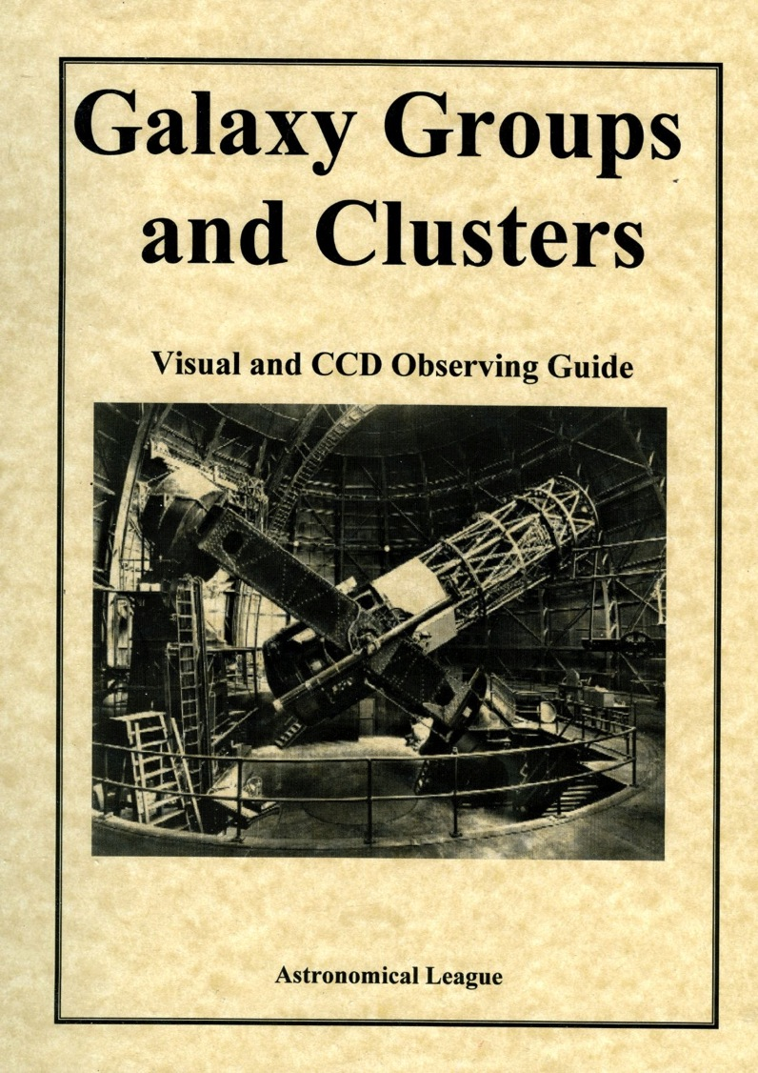

Slide 5
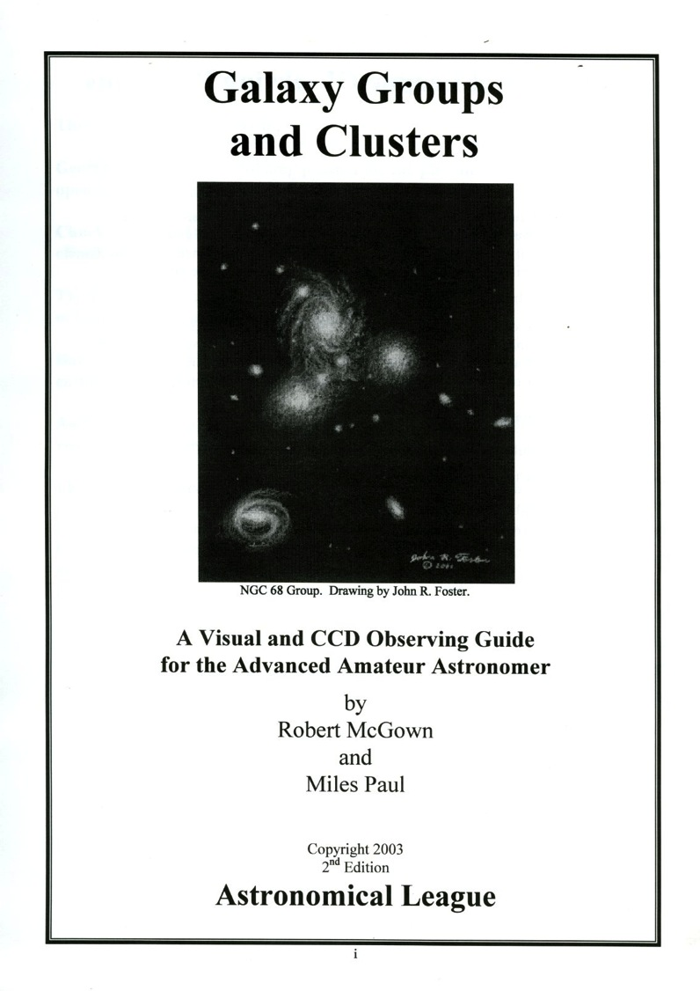
Few lists are more difficult than this one!
This book is chock full of finder charts …..

Slide 6
Whether or not you are a skilled observer does not depend on your telescope ….
….. any telescope of reasonable quality can be used …. An SCT, a Dobsonian, or a refractor …. although each may present its own difficulties and advantages. Keep in mind that the most important feature of a telescope used for deep sky observing is its APERTURE.
Notes:
There are other important items of equipment: 1) warm clothes, 2) a chair, 3) a table, 4) red lights, 5) filters

Slide 7
Getting an object into the field of view.

Slide 8
Star Atlases

Slide 9
Consider that a naked eye view of the sky will reveal stars to magnitude …
….. six or seven under ideal (seldom seen) conditions …. often only magnitude five. Mag five is the same view as that provided on Orion’s DeepMap 600. A glance at that chart reveals the problem – that most of what we see when we look at the sky at night is open space?

Slide 11
A mag 7 Star Atlas shows more …
…. as this page from Sky & Telescope’s Pocket Star Atlas, a popular accessory, demonstrates. Again, M100 is E of Denebola, but there are many mores stars to guide our telescope to targets.

Slide 12
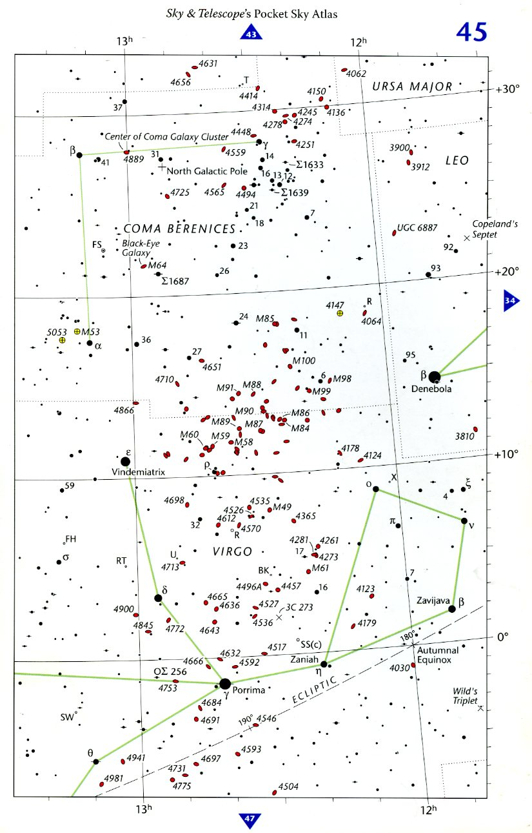
Mag 7 Star Atlas- M100 is E of Denebola

Slide 13
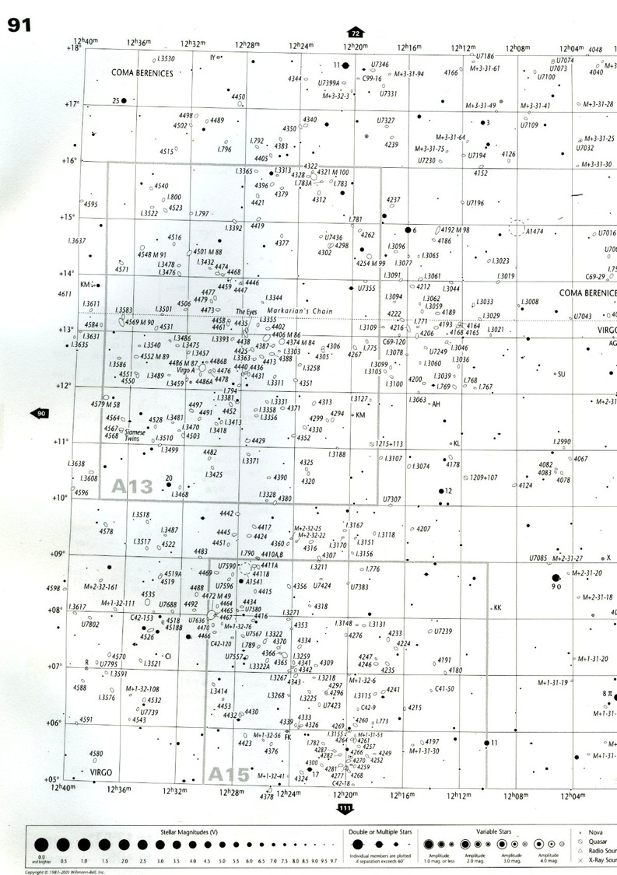
Here is the same area, this time from Uranometria, another popular atlas. The stars here are as dim as Mag 9.7. Denebola is off the chart to the West (right). M100 is seen in the upper left quadrant. A few more stars are seen for navigation, but there are large areas where there are no stars at all. Few, if any of the stars in the square “A13” would be visible to the naked eye.

Slide 14
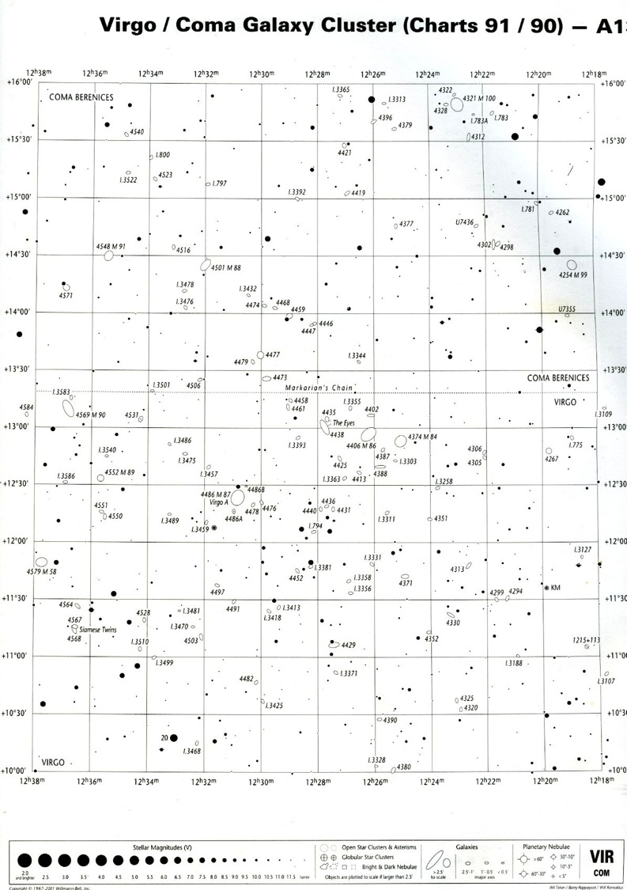
Here is a Mag 11.5 chart from Uranometria ….. There are a limited number of these in the atlas, covering only the most crowded areas. M100 is at the top right. There are many more stars for guidance, but many areas are still without navigational (starhopping) aids.

Slide 15
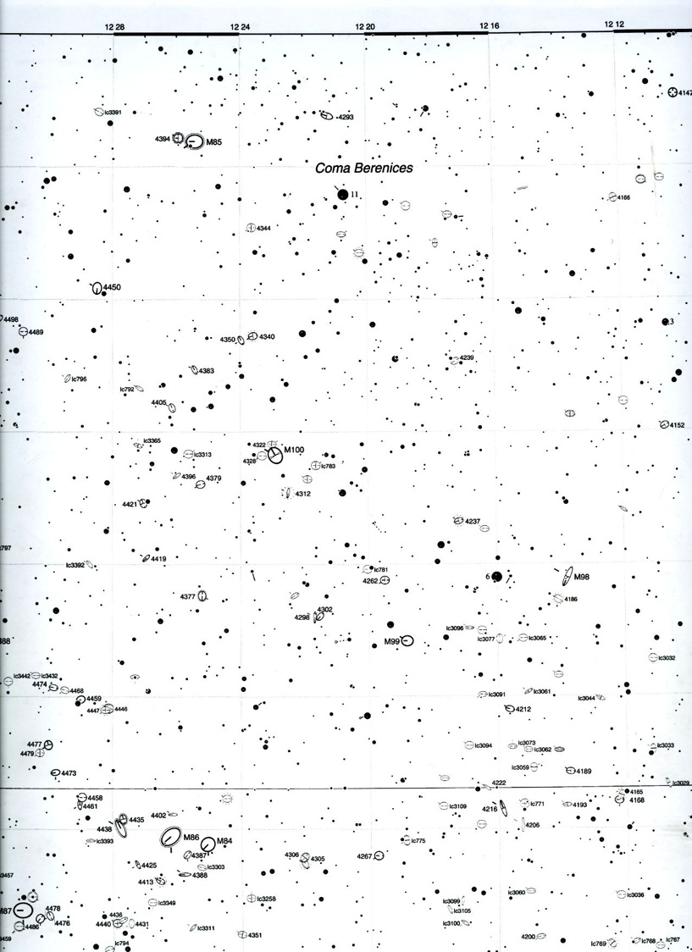
This is a page from the Herald-Bobroff Astroatlas, a hard-to-find book with charts as fine as Mag 13, such as this one. M100 is in the center. As you can see, there are enough stars to get almost anywhere with ease.

Slide 16
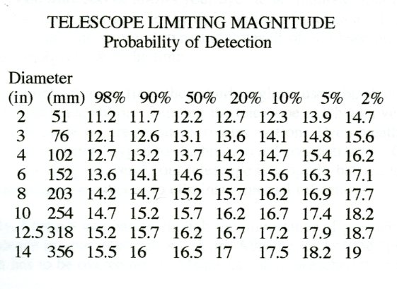
Of course a mag 13 star is awfully hard to see. Here is a chart which shows just how hard.

Slide 17
Finderscopes and Telrads
Notes:
Finder scope should reveal the dimmest star on the atlas page you are using ……

Slide 18
Finder Charts

Slide 19
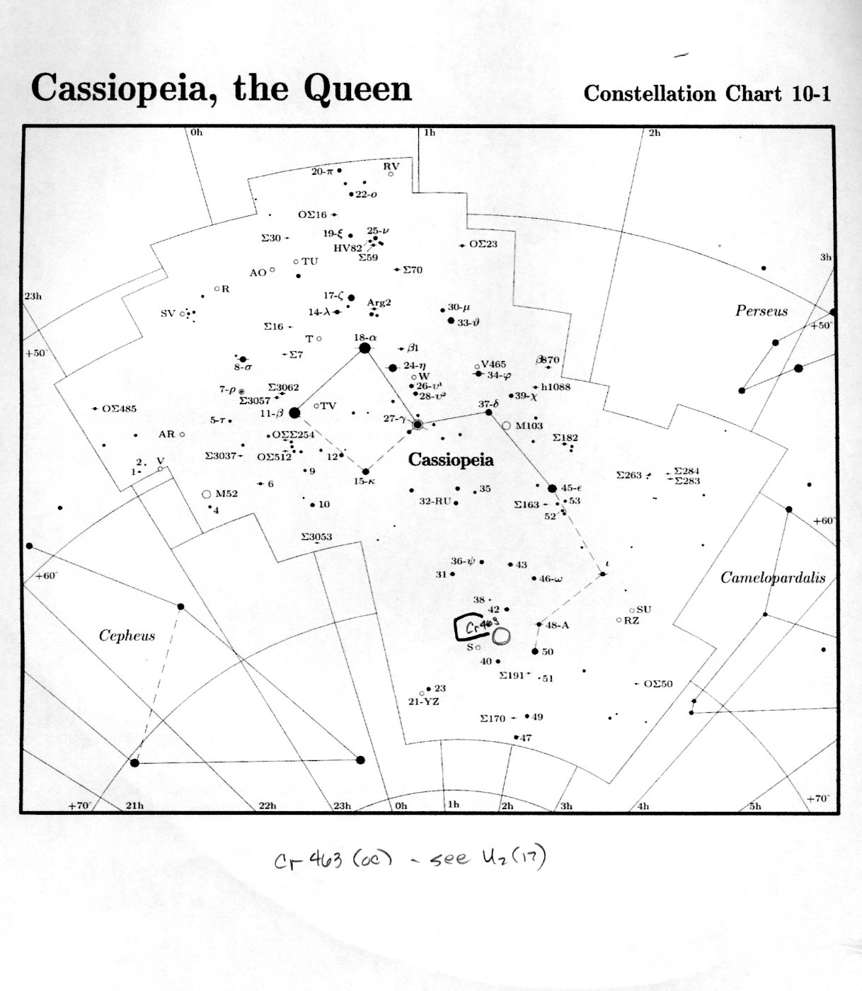

Slide 20
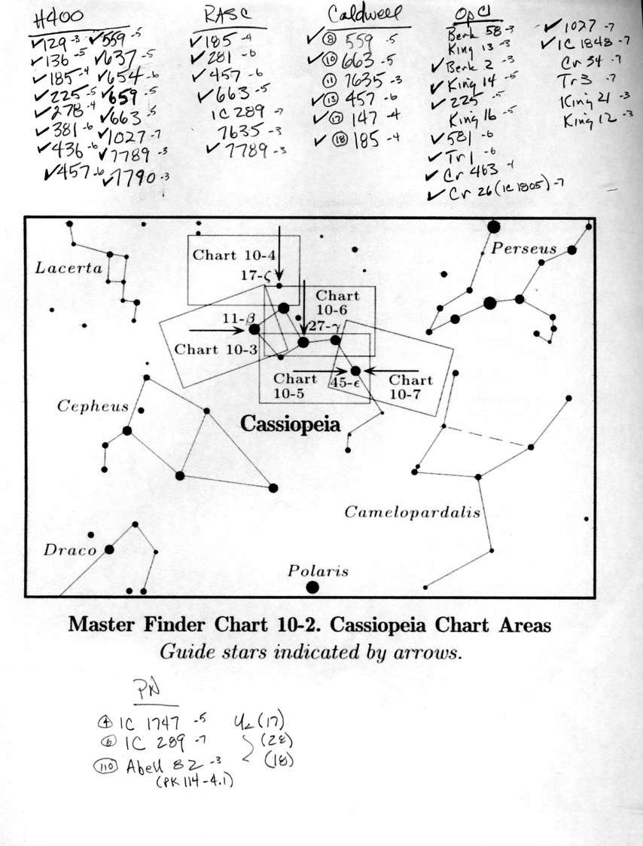

Slide 21
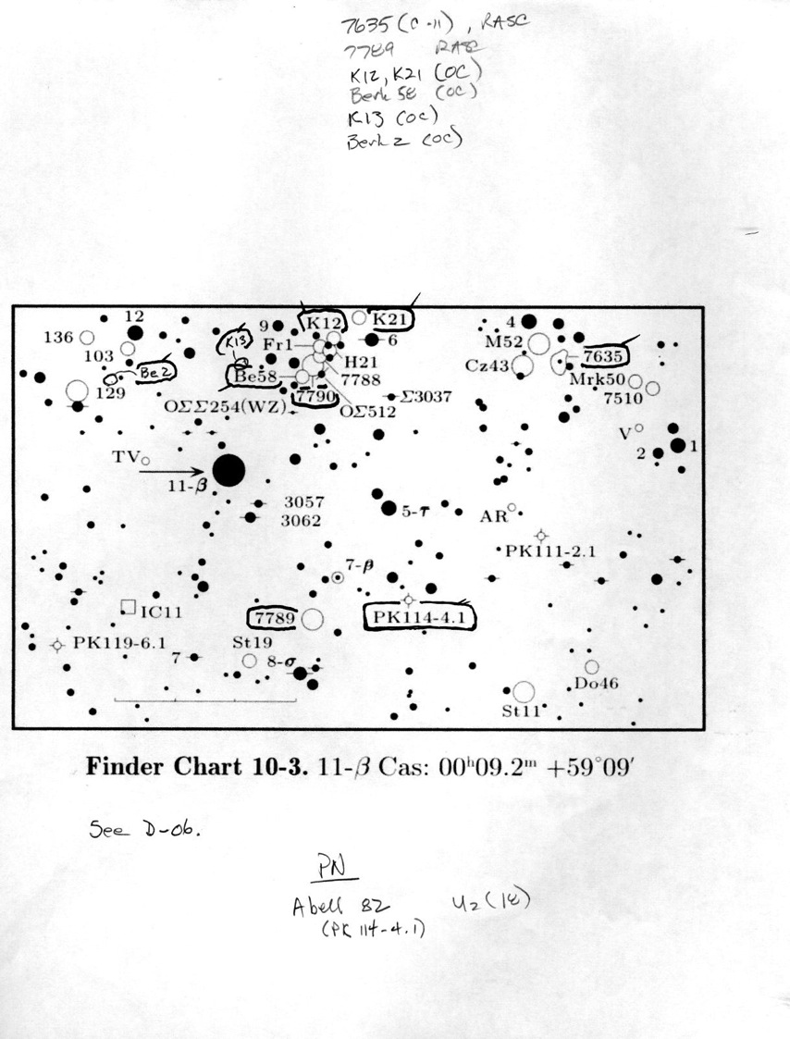
Stars here are to Mag 8…

Slide 22
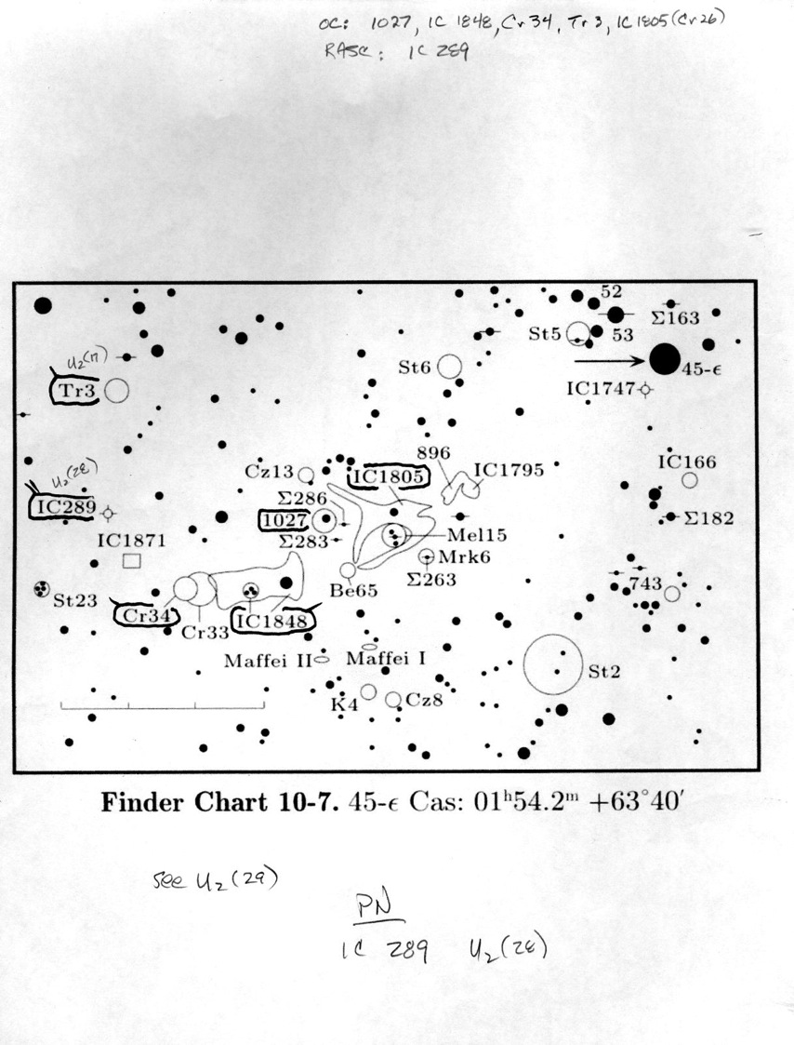

Slide 23
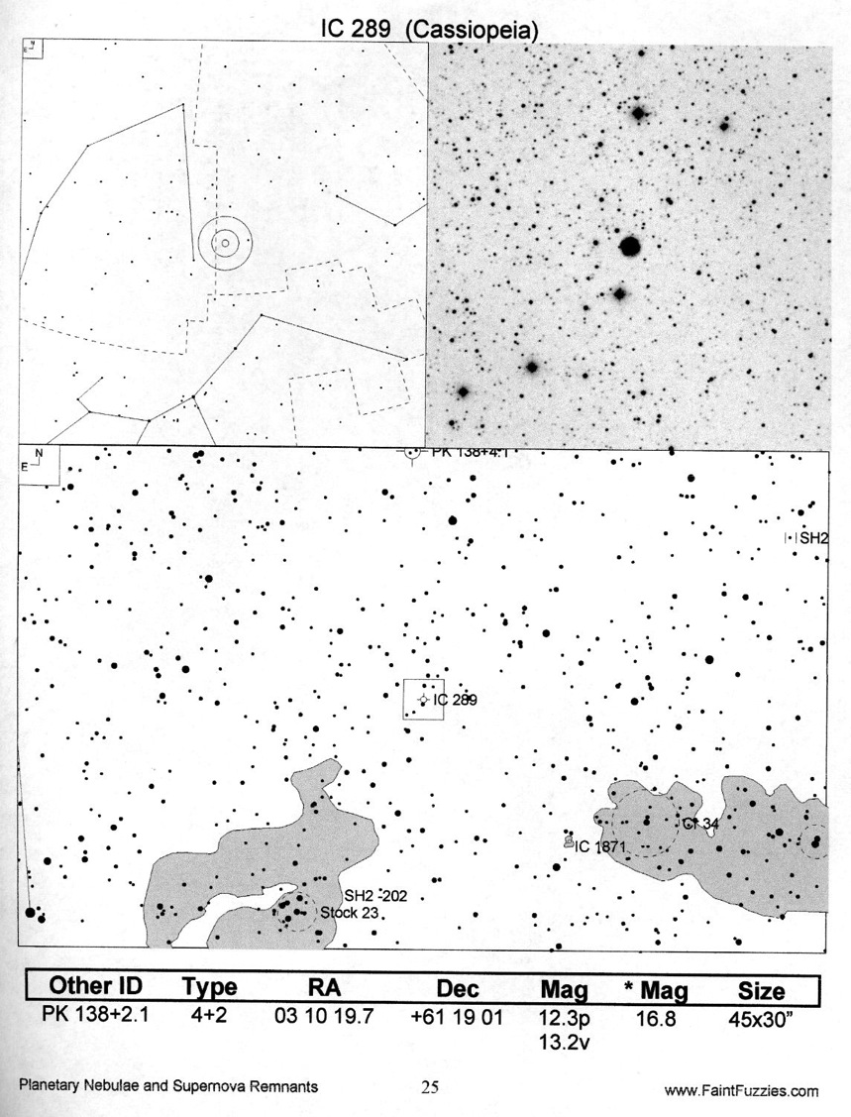

Slide 24
The infamous IC 289. Also known as “I don’t see 289”

Slide 25
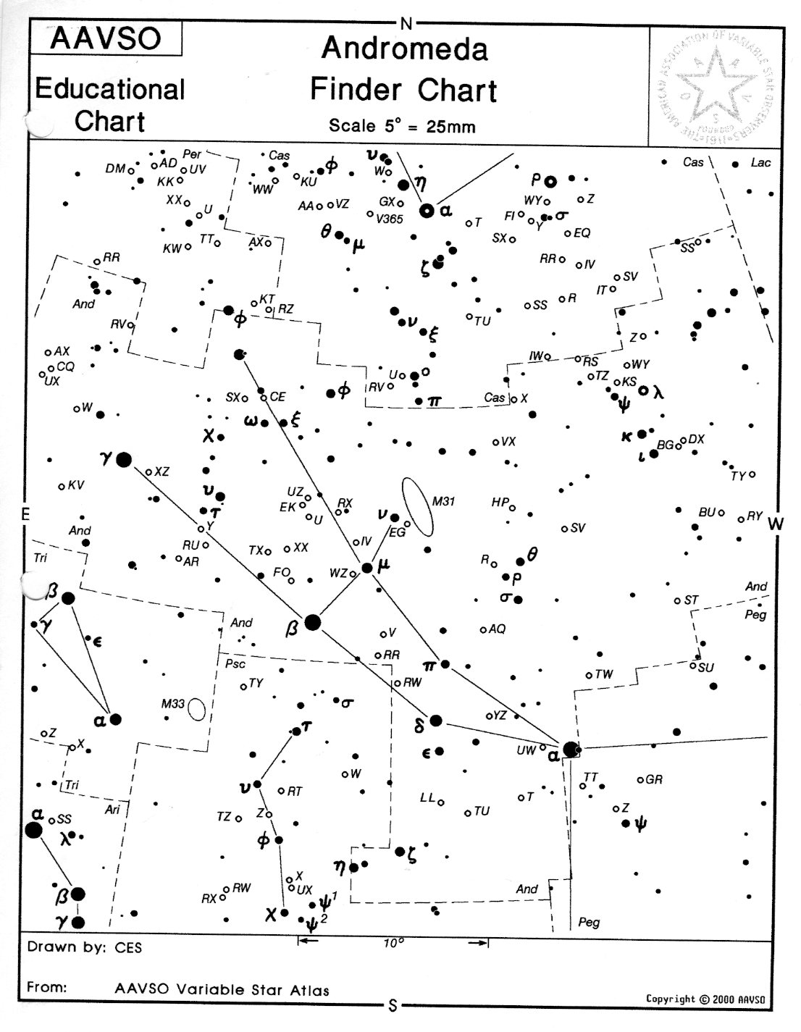

Slide 26
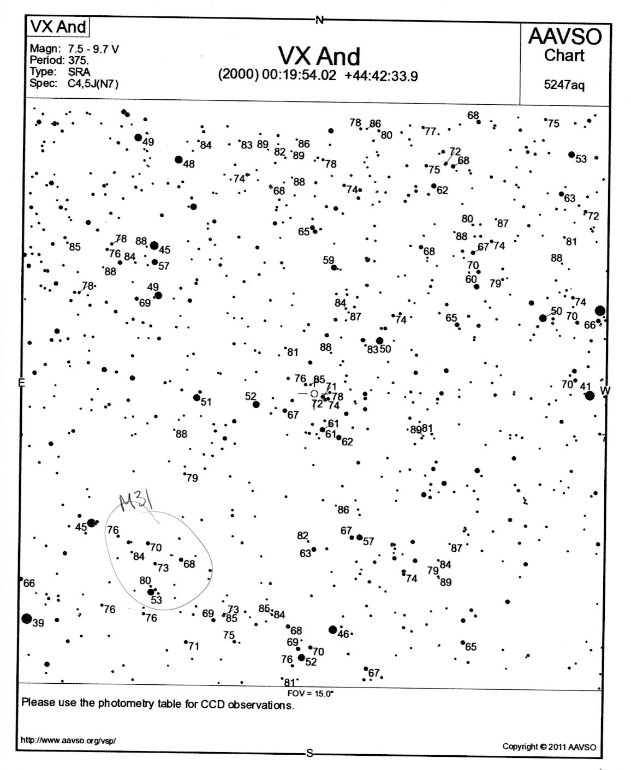

Slide 27
You’ve got it in the eyepiece ….. Now how do you see it???

Slide 28
“Telescopes are like musical instruments. It takes time to learn to play them well ….” Gary Seronik

Slide 29
“You can learn the principals in a few minutes ….. Have all the basic strategy demonstrated in a few minutes …. But it takes lots of experience to learn how to apply these strategies in different situations.” Jay Reynolds Freeman

Slide 30
What skills are needed?

Slide 31
Patience and Persistence How many times will you go back to look for IC 289, for the Horsehead, for King 25, for Seyfert’s Sextet?

Slide 32
Dark Adaptation Stray light Avoidance

Slide 33
Averted Vision

Slide 34
Focus Critically Change Magnification Employ Filters

Slide 35
Breath Deeply Move Scope Don’t Move Scope

Slide 36
Don’t forget these CRUCIAL items: Warm Clothes Red Lights An observing chair A table A logbook!

Slide 37
You don’t think that observing skills are learned and practiced? Go observing with _______ or ________ sometime, and you’ll see.

